Slide 1


Lincolnshire
Child Neglect
Resource
@Copyright Lincolnshire Safeguarding Children Partnership 2024

Slide 2

Child neglect is the most common form of child abuse. It is the most common reason for a child to be subject to an early help response, to be a child in need and to be subject to a child protection plan nationally and locally.
Many families face difficulties that impair their capacity to meet the child/ren's needs, and to provide parenting that helps children develop and keeps them safe so that they feel loved and cared for.
Addressing this serious issue for children and young people requires a robust evidence informed multi-agency response. We know from research that, by the time the threshold for child protection is met, children may have experienced neglect for several years, causing long term harm.
It is crucial that we address neglect early and we are equipped as practitioners to respond well to ensure that children’s needs are met and that they are effectively safeguarded.
Lincolnshire Safeguarding Children’s Partnership has developed this resource as a response to complexities that practitioners face in identifying, assessing, evidencing and responding to neglect.
Child neglect is identified as a common factor in national and local rapid reviews and Child Safeguarding Practice Reviews. It is recognised that there are challenges around identifying and evidencing neglect and understanding the impact neglect has on children.
This resource has been developed as an interactive and comprehensive guide to support practitioners to navigate such a complex issue.
We would like to thank Jane Wiffin for her interest and commitment to improving outcomes for children and for providing permission to adapt her work on child neglect. Jane has worked with several safeguarding services nationally on neglect and is currently a Practice Improvement Advisor for the Centre of Expertise on Child Sexual Abuse. Jane has also been an author on numerous Child Safeguarding Practice Review.
All Images provided by https://www.freepik.com/

Slide 3
The Child Neglect Resource has been designed to be simple for all practitioners to use. It is interactive and has been created to support a multi-agency response to neglect.
The resource is split into two sections:
Understanding Neglect
Responding to Neglect
Practitioners are encouraged to read the full guide, which will support with developing a broad understanding of neglect and what actions we can take to respond well. The resource has some interactive elements, and each section can be accessed individually to support you to access the relevant sections when needed. Each section covers the key points or themes with links to further resources which you might find helpful.
Within the Responding to Child Neglect section, you will find a range of tools and resources that we recommend using when working with families where neglect is a concern.

Slide 4





Using this resource
Please view this as a PowerPoint slideshow so that you can interact with elements throughout. To do this, click on the ‘slide show’ menu at the top and either select ‘From Beginning’ or ‘From Current Slide’
When clicked, this icon will return you to the main contents page (slide 6)
Where you see this image, you will find a directed task which asks you to reflect on a case or your practice. These can either be undertaken individually or as part of supervision or training exercises.
This image will take you to examples of practice or lived experience that have been shared in the development of this resource. You will also find links to relevant reviews where there were concerns around neglect.
This image will take you to an additional resources section in this guide or to an external resource that will support with the area identified

Slide 5
Using this resource for training or development
This resource can be used independently and as support for training or development by services.
Each section of this resource can be used in group training or supervision.
Training exercises or discussions can be held around individual pages or themes highlighted. You might want to focus a session on types of or signs of neglect for instance or consider working on how the word neglect is used in practice. You could also hold sessions focusing on tools and approaches, such as chronologies, writing SMART targets or using the neglect Scales to inform assessments. The content is designed to start conversations and reflections on a range of areas and can be used flexibly by any service.
You will find reflective exercises, case studies, videos and resources throughout which can be used in sessions, discussions or as directed learning which are designed to enhance learning and practice.
We encourage teams to use the resource and exercises in case discussions and during reflections of practice so that the learning can be applied to real life cases and is relevant to the work being undertaken in your teams.
This approach encourages ongoing learning, reflection, and development and will enable services to use the resource and tools in a way that supports practice within their service area.

Slide 6
Contents
7 | Understanding Child Neglect | 32 | Responding to Child Neglect
8 | Lincolnshire’s Guiding Principles | 33 | Identifying and Assessing Neglect | 63-65 | Chronologies
9 | Defining Neglect | 34-42 | Lincolnshire Neglect Scales | 66 | Hoarding & Clutter Scales
10 | Understanding Neglect | 43-47 | Early Help Assessment | 67 | Substance Use
11-12 | Types of Neglect | 48-49 | Capacity to Change | 68-70 | Mental health, wellbeing and trauma of carer/s
13 | Persistence and change | 50 | Neglect and the Criminal Justice System | 71-72 | Domestic Abuse
14-16 | Impact on the Child | 51 | Professional curiosity and record keeping | 73 | Learning and communication needs of family/carers
17 | Children with additional needs | 52-55 | Planning an Intervention | 74 | Environment and Intersectionality
18 | Signs of Neglect | 56 | SMART planning | 75 | Children with additional needs
19-28 | Causal Factors | 57 | Reviewing a Plan | 76 | Exploitation
29 | Omission or Commission | 58-59 | Working with Resistance | 77 | Online Safety
30 | Co-existence with other Types of Abuse | 60 | Barriers | 78 | Pregnancy
31 | The word Neglect | 61 | Tools and Resources | 79 | Summary
 |  | 62 | Voice of the Child
Note:
Use of the word Child/ren refers to Child/Young Person up to the age of 18 or 25 if services remain involved
Use of the word Carer/s refers to Parents and Carers

Slide 7
Understanding
Child Neglect

Slide 8
Click on the guiding principles below (from top left to bottom right) which relate to working with neglect in Lincolnshire.
Lincolnshire's Guiding Principles
Transparency
Strength Based Approach
We should always aim to be open and honest with families. It can be difficult to have conversations around neglect, particularly when the information you are sharing might be difficult for carers to hear.
It is crucial that carers understand concerns and that these are shared openly in a sensitive way. Working transparently ensures families have a clear understanding of what is working well, what we are worried about and what needs to change, meaning sustainable change is more likely.
Carers who are struggling to meet the needs of their child/ren will likely have needs of their own that will need to be addressed to improve life for the child. Whilst we provide support to the carer, we must not lose sight of the child and the impact that neglect is having on them.
Listening to the voice of the child is crucial in understanding their lived experience. It is important to consider how you will gather the voice of all children in the home, including those with additional needs and those who have English as a second language. The safety of the child is paramount. We should always ensure that risk and impact on the child is considered regularly, to avoid drift and delay.
In Lincolnshire, we are strength based in our approach when working with families. The Signs of Safety Framework encourages us to identify what is working well and to remain solution focused in offering support. Using the Early Help Assessment and the tools within this guide will support practitioners to work with families to make sustainable change in a positive and realistic manner.
Child focused
Be Professionally Curious
Working to prevent and address neglect appropriately requires professionals to discuss differences of opinion which often arise and to resolve these in the best interests of children; this includes appropriate challenge and use of the Professional Resolution and Escalation Protocol where appropriate.
Creating and promoting this type of culture avoids becoming desensitised to issues of neglect. We must reflect on our own practice and biases and challenge certain cultures or use of language within teams. It can be helpful to reflect on practice and cases within supervision or discussions with designated safeguarding leads to ensure we are always mindful of this. Where conversations are had around neglect in families, we should always be conscious of what is being done to address this for the child right now - We must not see issues of neglect as the norm.
We should always seek to understand the whole picture. Consider the best questions to ask to understand the lived experience of the child. Consider the environment in which they live; their home, wider family networks, culture, religion, education etc.... Use observations to gather wider information that build pictures of the environment the child is in. Use chronologies and tools to build up patterns that can support you to ask more questions.
Take a trauma informed approach when working with the family, consider what behaviours might be telling us. What past experiences might carers have had when engaging with services or as children themselves. Aim to be anti-oppressive in your approach and be aware of societal and economic factors which might be impacting on the family. Being professionally curious is crucial in understanding what is really happening for the family.
Culture of Challenge and Escalation
Professional Development
The relationships that children form within families and communities should be recognised and valued. The neglect of children is often linked to the chaotic lives, needs and difficulties of their carers, and extended family. In some cases, not all children in a family will be treated the same; one child may be perceived as different, perhaps due to the child’s age or needs. The response should recognise and respond to these needs holistically, without losing sight of the individual child.
Where appropriate, all family members should be considered in direct work, action planning and assessments, this includes fathers, wider family and other networks that the child identifies and values. .
Neglect is complex and requires a multi-agency response, that includes quality working relationships and collaborative approaches. It is important that we see the whole picture. Don’t be afraid to ask questions of other professionals to ensure you know what is being done, by who, and when.
Consider the needs of the child wider than the context of your own service. This encourages co-operation and information sharing which will reduce assumptions being made that can result in inaction. This should also include making clear records to ensure there is clear understanding of everyone’s roles and responsibilities across agencies.
Developing your professional practice is essential in responding to the complex nature of neglect. Use this guide to support you in navigating these complexities. The information, resources and tools have been compiled to support your direct work with families and to ensure a holistic approach to assessment.
Discuss this resource and how you can use the tools in practice during supervision.
Think Family
.
Multi-Agency Approach

Slide 9
Defining Neglect
Definitions and descriptions of child neglect help to provide benchmarks for practice.
The starting point for the definition of neglect must be children and young people’s fundamental right not to be subjected to inhuman or degrading treatment or punishment and to have a childhood that is free from abuse.
The European Convention on Human Rights (Article 3) and the United Nations Convention on the Rights of the Child (UNCRC Article 19).
The Government defines neglect in Working Together to Safeguard Children as:
“The persistent failure to meet a child’s basic physical and/or psychological needs, likely to result in the serious impairment of the child’s health or development. Neglect may occur during pregnancy as a result of maternal substance abuse. Once a child is born, neglect may involve a parent or carer failing to:
provide adequate food, clothing, and shelter (including exclusion from home or abandonment)
protect a child from physical and emotional harm or danger
ensure adequate supervision (including the use of inadequate caregivers)
ensure access to appropriate medical care or treatment
provide suitable education It may also include neglect of, or unresponsiveness to, a child’s basic emotional needs”
The World Health Organisation highlight that neglect can include isolated incidents, as well as a pattern of failure over time on the part of a parent or other family member to provide for the development and well-being of the child – where the parent is in a position to do so – in one or more of the following areas: health, education, emotional development, nutrition, shelter, and safe living conditions.

Slide 10
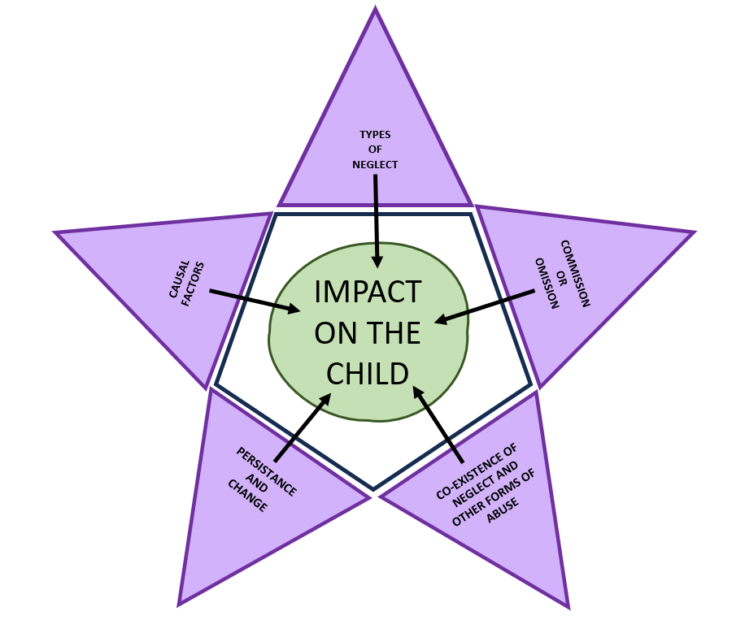
Understanding Neglect
Working to address neglect is complex and requires the consideration of six key areas.
Please click on the green circle at the centre of the star along with the 5 purple points (clockwise) to explore these further.
These areas are explored in more detail throughout this resource. They help to highlight the core elements of understanding neglect including:
The starting point and cause,
What is meant by persistence,
What type of neglect the child is experiencing,
How this is impacting on their wellbeing,
Understanding the actions of the caregiver,
and
Links to other forms of abuse.

Slide 11
Types of Neglect
There are five subdivisions of neglect. It is important to consider whether all five areas are experienced by the child, and if they are this is evidence of global neglect. For some children, some specific areas will be impacted, and this knowledge will help focus interventions where they are needed.
Physical | Health | Safety and Supervision | Love and Care | Stimulation and Education
This involves a carer/s failing to provide a child with: appropriate clothing, adequate food, hygiene and cleanliness appropriate home conditions and a safe place to sleep or ensuring that children have the skills to provide these where appropriate for themselves. | This involves carers: minimising or ignoring children’s illness or health (including oral health) needs, lack of attention to needs emerging from disabilities and failing to seek medical attention or administering medication and treatments. This is equally relevant to expectant mothers who fail to Prepare appropriately for the child’s birth, seek ante-natal care, and/or engage in behaviours that place the baby at risk through, for example, substance misuse. It also includes adults who perpetrate domestic abuse throughout or during pregnancy | This involves failure by the carer to provide adequate levels of guidance and supervision that ensure the child is safe and protected. This includes: Not being aware of where their child is or what they are doing, which may lead to being at risk of being harmed outside of the home or online Failing to provide appropriate boundaries that equip children to be aware of safety and risk Failure to arrange alternative care and supervision Leaving a child alone in a situation for which they are not equipped to manage, including around animals. This can affect children of all ages. It is important that the age of a child should not blur the fact that they have continuing developmental and care needs. | This involves a carer being unresponsive to a child's emotional needs, including: failing to interact or provide affection and comfort, failing to develop a child’s self-esteem and sense of identity, failing to respect a child’s sexuality and gender failing to provide appropriate boundaries that are consistent and clear enough for a child to understand and not being available to listen to worries or concerns. The carer may belittle, humiliate and blame the child seeing them as the cause of the harsh care they are being provided with. | The child does not receive appropriate learning experiences for their age and/or stage; they may: Be unstimulated, Be denied appropriate experiences to enhance their development and/or experience a lack of interest in their achievements, lack of help with homework lack of support to resolve difficulties at educational settings This may also include carers failing to comply with requirements regarding school attendance and responding to any special educational needs.

Slide 12
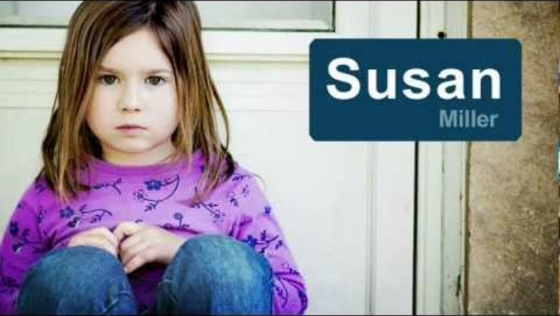
Types of Neglect
Watch this short video (2:24) - What types of neglect can you identify from Susan’s story?

Slide 13
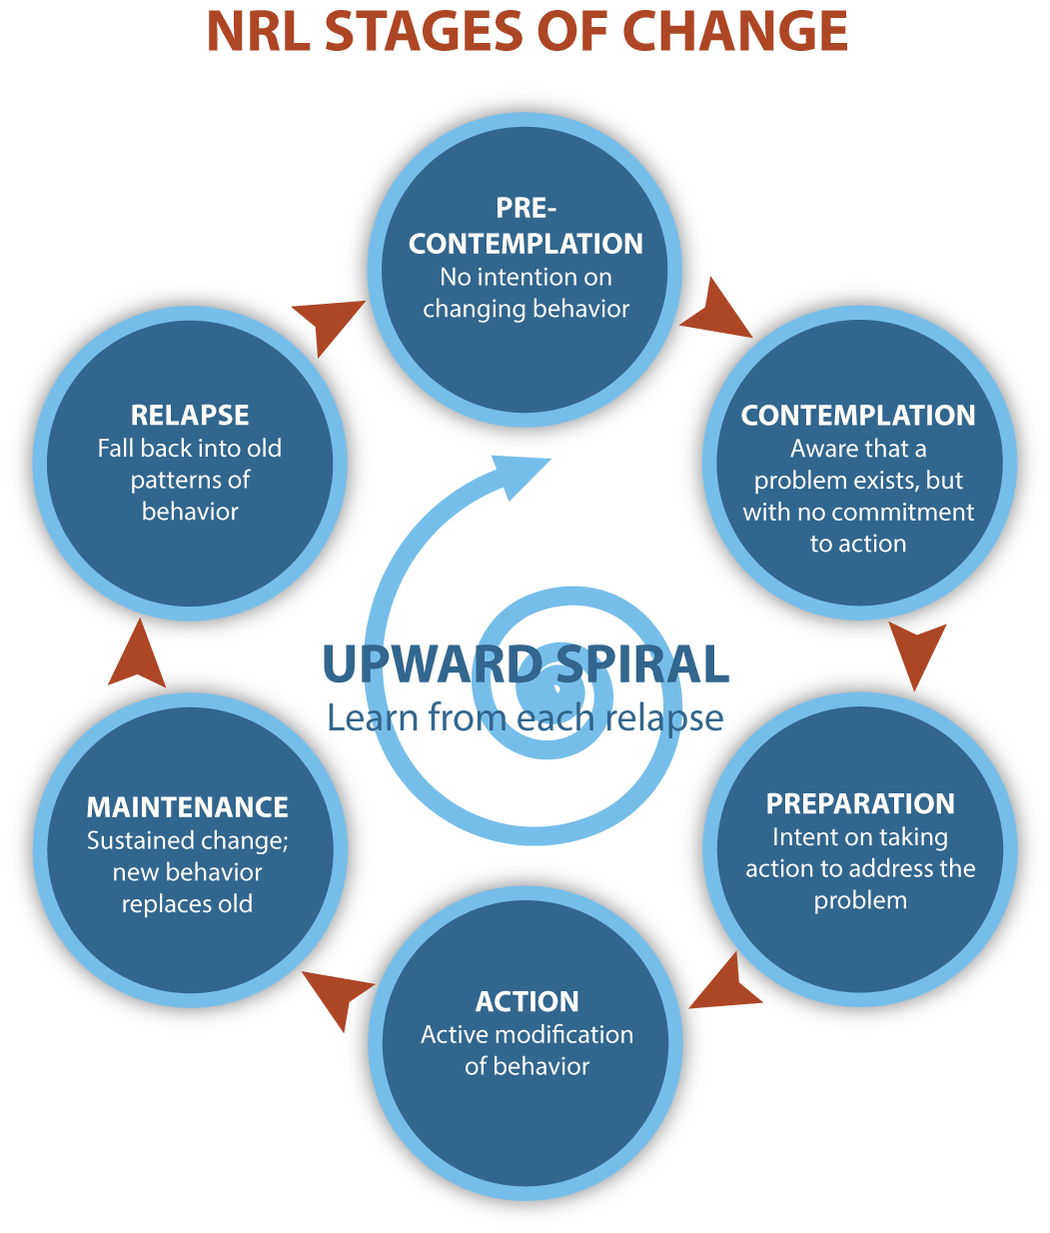
Persistence and change
Child Neglect is usually (but not always) something that is persistent or pervasive, cumulative, and occurs over time. Therefore, a significant incident does not need to occur.
The cumulative effect of neglect can be corrosive to children’s development because it becomes part of everyday life. Neglect needs to be understood in the context of a child’s age, stage of development and the amount of quality parenting/caregiving needed to ensure appropriate care and safety
Neglect requires the collation and analysis of sometimes small and seemingly insignificant events that only provide evidence that neglect is an issue of concern when viewed together. The use of chronologies and timeline tools, found in the ‘Responding to Child Neglect’ section of this resource should be used to support practitioners to build up this picture.
Persistence needs to be understood alongside the importance of parental and family change. There may be a history of support and services being provided to carers without sufficient engagement or capacity/motivation to change.
This history needs to be understood in the current circumstances and a professional judgement made about capacity. The cycle of change (opposite) can support practitioners to make these judgements, by considering important questions, such as:
Is the carer thinking about the need to change?
Are there indicators of planning and action to support change?
Are they motivated and positively engaged with others to secure change?
For further information and a full list of useful questions to consider, please visit Scottish Government National Risk Framework to Support the Assessment of Children and Young People
Neglect can also be of recent onset or occur as a result of a one-off serious incident and still needs to be taken seriously and the impact on the child or young person evaluated.

Slide 14

Impact on the Child
Video length 5:10

Slide 15
Impact on the Child
p
Child Neglect can be far-reaching in its consequences for a child. Experiencing neglect is likely to make a child’s everyday life miserable whilst also affecting aspects of their development and growth. The persistent nature of neglect is corrosive and cumulative and can result in irreversible harm, it is also likely to influence the relationships children make with others in both early and later life and have an impact on how they parent their own children. Early recognition and prompt intervention to prevent these cumulative negative effects are therefore crucial. | The impact on a child will depend on the age at which neglect occurs, how long it has been going on and the extent of the areas of development impacted. It is important to understand the individual impact of neglect on each child, but research suggests that the potential impact is in these key areas: Pre-natal neglect Health and physical effects Emotional effects Trauma related behaviour Social effects Later effects – Adolescence and adulthood Each area is explored further on the next page.
Consider a child you are working with right now. What does their everyday life look like?
How might their lived experience impact on their social, emotional or physical development?
How might these experiences impact on this child through childhood and into adulthood?
What can be done to create change for this child?

Slide 16
Impact on the Child
Click each section below to explore these impacts further:
This can occur through drug and alcohol use in pregnancy, a failure to attend pre-natal health appointments and/or follow medical advice and can include exposure to domestic abuse.
This can cause:
prematurity
low birth weight
brain damage and disabilities,
withdrawal symptoms and Foetal Alcohol Spectrum Disorder (FASD)
and
can increase the risks of sudden infant death syndrome
A child’s early brain development can be affected in ways which influence how they react to stress and other stimulating situations in their early and later life.
A child might experience health and physical effects of neglect if they have experience of:
being underweight or grossly overweight,
having persistent infections,
late development of abilities such as walking,
being tired and listless
having toileting problems
Cognitive difficulties such as language delay
Children may find it difficult to concentrate or express feelings and physical injuries can occur because of accidents due to lack of care or supervision.
The bonding between child and carer is essential in shaping secure attachments. A child who experiences neglect may develop insecure attachments. Where neglect is a result of a single incident, or the neglect occurs at a key transition in childhood (such as at the point of adolescence) this change in experience can lead to :
Low self-esteem and self-regard,
Anxiety and Depression,
Over-compliance or a lack of emotional regulation,
Issues with developing a sense of self
Difficulties in seeking emotional support and help from adults
Problems with forming relationships
Pre-natal neglect
Health and physical effects
Emotional effects
Experiences in childhood shape how a child sees the world and their understanding of relationships. Where a child has adverse childhood experiences, this can lead to:
Social isolation due to difficulties in forming and keeping friendships, being bullied or being ignored by peers;
Social exclusion through dysregulation, which may lead to adverse outcomes; such as school exclusion or becoming know to the police. This can be self-reinforcing of low self-esteem and helplessness.
Poor school attendance and attainment which means the child does not reach their potential.
A lack of opportunities to be successful in other spheres such as sports or creative activities.
Social isolation and/or social exclusion may put a child at risk of being exploited.
Social effects
Adolescent neglect is a significant issue facing young people and can be of long standing or of recent onset. Resilience to neglectful situations does not increase with age and can have significant consequences for young people’s emotional wellbeing. Children who feel that their needs are responded to inconsistently or not at all may feel misunderstood or unheard and this can lead to:
substance misuse,
criminal activity,
sexually harmful behaviours,
being at risk of being exploited,
self-harm and suicide attempts,
difficulties in forming relationships, including being in relationships where domestic abuse can occur,
adopting parenting styles which may pass on similar problems to their own children
You should consider the accumulative impact of neglect and how a loss of childhood experiences will have impacted the way in which this young person has developed and their understanding of where they belong. To understand the child's lived experience and understanding of this, consider the whole picture and how they have become who they are. To read more about this, visit Growing up neglected: a multi-agency response to older children (publishing.service.gov.uk)
Later Effects-
Adolescence and adulthood

Slide 17
Children with additional needs
The meaning of the child is often seen in child safeguarding practice reviews where a child’s behaviour, mental health or disability is reported by the carers as the reason neglectful care is provided. It is important that there is an understanding that a child’s behaviour can be the result of developmental and emotional needs not being met through care and/or parenting.
Children with Disabilities are nearly 4 times more likely than other children to be abused or neglected. Children with special educational needs and disabilities (SEND) are more likely than other children to be abused or neglected (Safeguarding Network) | Most research suggest that disabled boys are at greater risk of abuse than disabled girls when compared to non-disabled children | For some disabled children, a failure to provide a certain level of care can result insignificant damage to their development, health and well-being yet this is not always recognised | Communication difficulties may make it difficult to tell others what is happening. | Children not being brought to appointments can become a repeated pattern. Using professional curiosity to explore the reasons behind this is key and can help to identify concerns around patterns and lack of engagement. Watch this short video (2:02) to find out more.
1 in 6 young people in England (aged 5 to 16) experienced a mental health problem in 2020 (NHS) | Children aged 8 to 16 who experienced mental ill-health were more likely to have parents who could not afford: for their child to take part in activities outside of school or college to buy the right clothes, shoes, or equipment for school or college transport or did not have access to transport to take their child where they needed to go (NHS,2023) | Childhood emotional neglect can damage a child’s self-esteem and can invalidate their wishes and feelings. | Not responding to these needs and/or parenting in a way that impacts a child’s mental health is neglectful.
In these circumstances it is key to consider how any additional needs might make the child more vulnerable and how neglect might impact on this.
Think about the below
How are additional needs interacting with the care the child is receiving, including their environment. | Where a child has a disability, they may be significantly more impacted physically by a lack of heating or balanced diet or attending medical appointments. Where concerns exist around physical care professionals should consider the impact on the child with focus on their specific needs and any vulnerabilities they may have. | Where concerns exist around mental health or suicide, and risk would increase if a child were left alone, consider this need as a priority over the age of the child. Is the safety plan robust and being followed.
Click this image for additional resources

Slide 18

Signs of Neglect
Signs of neglect may vary by child, there are specific age-related indicators to consider which may be signs that neglect may be present or may become an issue. These examples are not exhaustive and there may be cross over between ages and stages.
Pre-birth | 0-4 years (Pre-School) | Primary School (4-11 years) | Secondary School/Further Education (11-18)
A lack of engagement with ante-natal services Delayed attendance at a service -at a late stage in pregnancy Not following health advice A lack of interest in the baby and/or becoming a carer Engaging in behaviours that place the baby at risk To support practitioners in identifying neglect at this stage, please visit the responding to section, available here. | Concerns around growth and development; including concerns around weight, speech and language delay, delayed toilet training Health concerns, such as recurring and or worsening nappy rash, infections and injuries Repeated failures to bring the child to appointments Signs that a child is unusually clingy, withdrawn, over-familiar with strangers and/or where self-soothing behaviours are evident (e.g., rocking, head banging) Concerns around carer following safe sleep advice Difficulty regulating emotions and or/ behaviour Lack of appropriate and consistent boundaries being set by carer | Low school attendance Difficulty regulating emotions and/or behaviour Poor hygiene, including dental hygiene Poor social skills Concern around presentation, weight and/or development Concern around ability to follow routines, rules limited attention span | Low school attendance Concern around concentration or behaviour, such as being withdrawn or disruptive in school Concern around wellbeing, including Self-harm Lack of appropriate and consistent boundaries being set by carer, which put the young person at risk Frequent missing episodes, particularly when carer is unaware of child's whereabouts Concern around who the child is spending time with, such as inappropriate adults or groups Increased concern around risk-taking behaviours, including drug and alcohol use, involvement with the police, and exploitation (to find out more about responding to exploitation, click here)
 | Supervision (0-11 years) Limited or no supervision indoors or outdoors, supervision not in line with age/level of development Limited or no awareness of where child is or what they are doing, including online activity |  | Supervision (11-18) Carer not aware of whereabouts of child Lack of appropriate boundaries being set, or guidance being given to ensure child is kept safe and understands risk
 | All Ages Concerns around discipline styles. These resources are useful to consider Positive Discipline in Everyday Parenting,
neglect
Could
this
be
?

Slide 19
Causal Factors
If the neglect of children is to be prevented and risks reduced, it is essential that professionals are equipped to understand the causal factors underpinning neglectful care
Research suggest that there are several factors that can impact a carer's life effecting the quality of care received by children. "In England this has been accompanied by record levels of children in out-of-home care, with more than one child in 60 being investigated for abuse or neglect each year. Major reviews of children’s social care in England and Scotland have affirmed that family poverty and inequality are key drivers of harm to children." P. Brewster et al (March 2023) Social exclusion, poverty, living in stressful environments, poor ill-health, lack of family support and refugee status can make the task of parenting complex, and it is the coexistence of many of these factors with domestic abuse, mental ill-health, substance misuse and learning disabilities that is likely to underpin neglectful care.
Many carers who neglect their children have experienced significantly adverse childhood experiences themselves. They may have been neglected, physically, emotionally and sexually abused and experienced loss and rejection. Adverse childhood experiences and current external stressors cast a long shadow. Carers may be unable or not equipped to cope with the complex psychological needs of children or to form appropriate attachment relationships. Carers may struggle to keep children in mind, feel empathy, and recognise their children’s needs for care and protection.
It is helpful to consider the most common causal factors linked to neglect. However, it is essential that the needs of the child remain in focus so that the presence of any causal factor is understood through the lens of the 'impact on the child’. The following pages explore these in more depth.

Slide 20
Causal Factors
This next section of the resource covers Substance Use, Mental Health, Domestic Abuse, and Learning Disability. Additionally, there are two pages that cover Environment and Intersectionality and Trauma. These two sections are provided for wider context and to draw attention to how they interact with some of these causal factors. There are four areas in each section, which cover the below.
A description is provided in this box. Specialist advice may be required. It is essential that there is a collaborative and joined up approach between those working with adults who have complex needs. | The green box highlights actions you might take to support a family who you are working with. This might include tips on communicating, best questions, or key themes that you might want to ask about in certain circumstances. Questions are provided only as examples and may not be relevant to the family you are working with; however, we hope that they might provide some ideas on how to formulate best questions and key areas of focus. In Lincolnshire, professionals strive to support children and young people using a whole system and family approach; understanding that families can be worked with to achieve their potential, by either preventing difficulties or stopping things getting worse. Professional curiosity is essential in understanding many aspects of an adult's life and can aid our understanding of the interrelated factors within a family and the environment the child lives within.
The blue box will provide details on how these factors impact on the child.
You will see the below image on each page, this acts as a link to resources that are specific to that causal factor.
You may wish to consider any cases you are working on where these casual factors might be present. Reflect on whether these factors have been considered or discussed. What impact might they be having on the carer and child/ren. What direct work and/or planning can be done with the family to acknowledge this and support them?
This can be considered independently or as part of group training or supervision within services. It might be worth focusing on each causal factor in depth. Consider these reflection points and how teams and agencies might work to understand these factors further. You could also use the case studies, resources, and/or videos provided as a starting point in these sessions.

Slide 21
Substance Use
Drug and alcohol use by carers does not inevitably lead to poor outcomes for children, but where there is a problem, each aspect of their lives may be affected
Parents and carers who have a substance use problem can have chaotic, unpredictable lifestyles and may struggle to recognise and meet their children’s needs. This may result in their children being at risk of harm. We're using the term ‘parental substance use problems’ to talk about parents or carers who have long-term problematic use of drugs and/or alcohol. This includes parents and carers who: consume harmful amounts of alcohol (for example if their drinking is leading to alcohol-related health problems or accidents) are dependent on alcohol use drugs regularly and excessively are dependent on drugs." Parental substance misuse | NSPCC Learning
NSPCC noted other psychological effects for the child include, preoccupation with their parents’ substance use, blaming themselves for their parents’ behaviour, not being able to attend school regularly and/or having poor educational attainment, difficulty establishing and maintaining healthy relationships, developing behavioural, emotional or cognitive problems. *Mental and physical development of a child can be affected during pregnancy and Foetal Alcohol Spectrum Disorder is an example of this.
Communicating | Questions
Find the right moment and be prepared. Use I statements that are clear and direct. Use active listening and practice patience. Determining how and when the substance is used will inform intervention and plans that include safety. Any concerns of substance misuse need to be assessed with care, and this may involve knowing more about any immediate dangers and risk that could be present in the child's environment. There should be a clear understanding regarding the - level and type of substance use, prognosis for change, commitment to reduce or control substance use, motivation for use and if this is response to stress and a 'safety behaviour’. Benefits of working with a substance support agency will include the robust monitoring of reduction, management, or abstinence adding to any information available from any self-reporting. | Describe the type of parent you want to be? What is stopping you from being that parent? Explain how you think your substance use is impacting on your child? Describe the plan you have in place to keep your child happy, fed, stimulated, safe etc.…? On a scale of 0-10 mum/dad where 10 is you think you are doing a great job of meeting all of your child’s needs (fed, clothed, clean, educated), and all of your support network would say this too and 0 is you are not looking after your child at all and they are saying they are hungry, not clean and have dirty clothes, where would you scale and why?
These tips and questions are likely to be useful when working across the causal factors highlighted, so please adapt these and use as you see fit.
Click this image to read an NSPCC
report on learning from case reviews where substance use was present
Click this image for resources

Slide 22
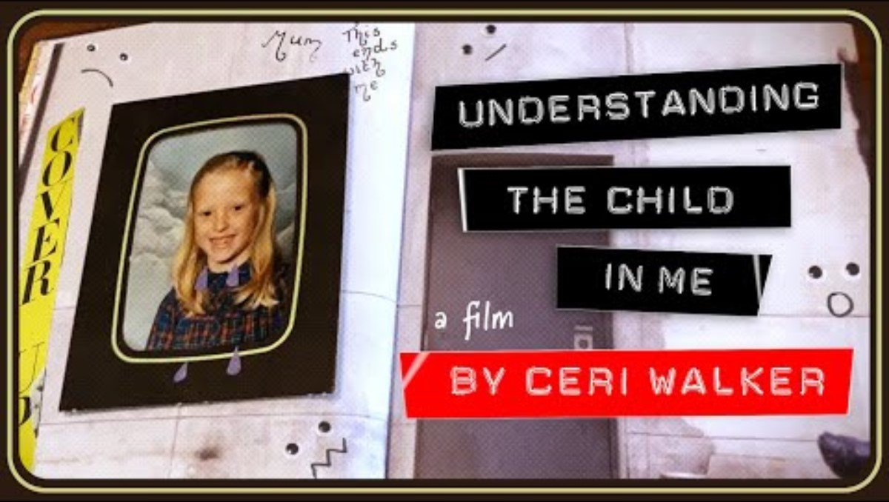
Substance Use
Watch this short video (3:51) by Ceri Walker, titled ‘Understanding the child in me’, which shows the impact of parental substance use

Slide 23
Mental Health
Studies and reviews highlight the importance of early support in mental ill-health of carer/s. Just over 1 in 4 new and expectant mums experience mental ill-health during their pregnancy and the first year following the birth of a child. [1] There is less research about the fathers and their mental health, however we know that becoming a parent and the pressures associated with supporting a new family can impact upon male carer’s mental health too.
Where there are concerns around mental health, including more common symptoms, such as low mood, anxiety and stress, the needs of the children should always be paramount. Many carers who experience mental ill- health can provide safe and loving care for their child, without any negative impacts on their child. In some circumstances however, Carers may need support with their mental health and wellbeing. Support from family members, friends, neighbours and/or professionals can be crucial in helping them to care for their children.
The NSPCC use the term ‘parental mental health problems’ to define a parent or carer who has a diagnosable mental health condition. Which can include, Depression, Anxiety disorders, Schizophrenia, Bipolar disorder, and/or Personality disorders.
Mental ill-health can vary in severity and impact a person’s day-to-day life in a variety of ways. This can depend on a carer’s support network and their individual circumstances and experiences. Mental ill-health might occur alongside other stressful life experiences.
The type of mental ill-health, presenting behaviours, and individual circumstances are factors that need to be considered in any assessments and the impact of these on 'parenting capacity’. When identifying mental ill-health as a concern in any assessment or plan, these should be outlined as detailed as possible, including examples and descriptions of the behaviour being displayed and the impact this is having.
There should always be an early assessment of need considering the child's developmental needs the family and environmental factors and parenting capacity.
Regarding mental wellbeing, responses to caregivers at times of change and stress, such as the birth of a child, is essential and can support positive emotional attachment.
Consider some of the advice on the previous slide regarding communicating and questions. You may also wish to consider these additional questions:
What or who is making this situation harder for you to deal with right now?
What do you think needs to happen to change this?
It is estimated that 50,000 children and young people are caring for a parent with mental ill-health. In this situation, where a child is acting as a young carer for a parent with mental ill-health, it is less likely that the person affected by mental ill-health will seek support, compared to a someone who is being cared for by an adult [2].
Where the care provided for a child is impacted by a carer's mental health, this can affect a child’s attachment. The security of attachment forms the building blocks for a child’s socio-emotional development. Disruptions in attachment (so-called insecure attachment styles) can lead to long term difficulties in development, and can cause significant psychological, behavioural and functional impairment in later life [3].
Some forms of mental-ill health may impair a parents' ability to consistently demonstrate emotions and feelings or could cause them to be appear "unavailable" or unresponsive to the child. In some circumstances children could be exposed to behaviour from the parent that they find confusing, distressing or could place the child at immediate risk.
Click this image to watch a video demonstrating how words and pictures were used to help Callum understand his mum's mental health.
[1] NHS England (2024) Perinatal Mental Health
[2] The Children’s Society (2018). Young Carers in Families Affected by Parental Mental Health Illness
[3] National Institute for Health and Care Excellence. (2021). Postnatal Care: Emotional Attachment. NG194 Evidence review O (nice.org.uk).
Click the image
for resources

Slide 24
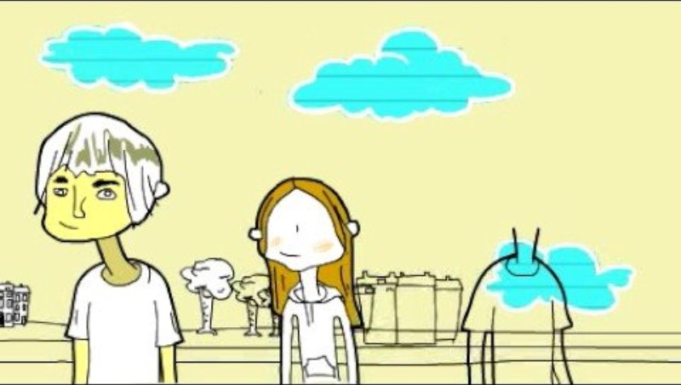
Domestic Abuse
Professionals should remain alert to the indicators of neglect whenever domestic abuse is raised as an issue and equally consider whether the child is exposed to domestic abuse when working with cases of neglect.
Women's Aid describe domestic abuse in this short video (1:08)
Always take threats of suicide or threats to kill a partner or child seriously and take immediate action to keep children safe.
Perpetrators of domestic abuse must be held responsible for their behaviours and actions and a clear link made to neglect. The needs of the child are central to planning and responses should focus on creating and monitoring safety within the context of the abuse.
Encourage reports to the police and discuss when to call using 999 followed by 55 when it is unsafe to speak. Ensure you keep records that include any police incident numbers.
Encourage sharing what is happening with family and close friends who can offer support. Advise on relevant support services available to them and support them to access these.
It is important to let them know the domestic abuse they are experiencing is not their fault.
You can also offer advice with IT safety (The Cyber Helpline). For concerns of stalking there is also an app called Hollie Guard. It is not advised that someone blocks a person who is stalking. This could encourage a change and escalation in behaviour.
Any person who is concerned about potential domestic abuse can make a Claire's law application. If there are Police held records regarding history of abuse and concerning behaviour, the named victim can be informed.
Completing a DASH/S-DASH with the person experiencing abuse will help to consider any risk and should be completed at each new incident or change in situation. Full guidance on completing these can be found on the link above. The scoring will support any professional judgements made regarding onward action to address the concerns in a multiagency meeting through MARAC.It is advised that the person receiving the information is alerted to the referral wherever possible.
The Domestic Abuse Act 2021 states that Children should be considered as victims in their own right. You can access guidance here
The NSPCC discusses domestic abuse as a safeguarding concern and highlights some of the impacts below on children:
They are denied a positive role model
The abuse can harm the parent-child bond and impact attachment
They can develop negative core beliefs about themselves
They can be isolated from helpful sources of support
Their coping and survival styles may become problematic
They can believe that victimisation is normal or inevitable and develop rationalisations for the abuse.
This simple video from Kaleidoscope UK highlights the impact of domestic abuse.
Click the image
for resources

Slide 25
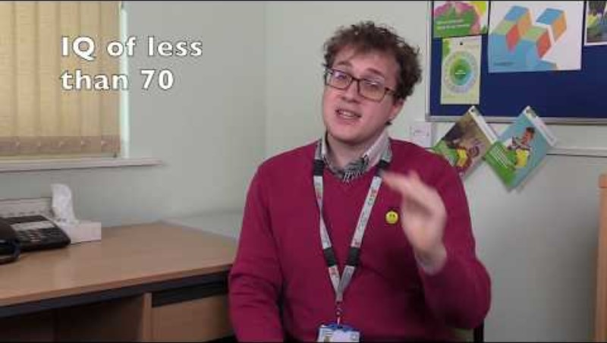
Learning Disability
Carers with a learning disability can and do become good parents. Support can be put in place to build skills as well as address some of the additional complexities that can be present with increased poverty, discrimination and poor self-esteem.
While there is no association between learning disability of a carer and child abuse or wilful neglect, there is evidence that children may suffer neglect from omission as a result of a lack of parental education and appropriate, supportive resources.
Where a carer may have difficulty with understanding or communication it is essential that we understand how this impacts on daily life, including routines, attending appointments, understanding instructions, taking action and parenting.
It may be useful to enquire about the carer's education history, did they attend a specialist provision? Can the person read, write and/or tell the time? Have they got a driving license? Do they live independently or with support? It would be useful to also ask how they prefer information to be shared. To ascertain this, you can ask them if there has been information shared in the past in a useful way or if there are any examples that have not helped.
You could ask - Thinking about a time in the past when you have struggled with something like this, who has been around you to offer support, and what did they do? If I asked your (friend, mum, dad) how to help you the most when learning new things what would they say? The answers to these questions will help you to work realistically with them and ensure you consider their needs.
Effective support in these circumstances should ideally be available from pre-birth, and may need to be ongoing, flexible, and at every stage of a child’s development. It must be based on respect for the carer and for the emotional bond between them and their child. Professionals should recognise carers as a resource and not the problem. Support should be strengths-based focusing on the whole family and should foster control and feelings of competency in the carer. It should recognise that families are best supported in the context of their own extended families, neighborhoods and communities.
Surrey and Borders Partnership NHS Trust have created a video that explains Learning Disability and difficulties. (4:55)
Where a carer has a learning disability, this might impact on some of the below:
The carer may have difficulty developing and sustaining relationships or have relationships that may present a risk to the child.
The child may take on roles and responsibilities within the home that are inappropriate.
The carer may neglect their own and their child's physical and emotional needs.
A learning disability may result in chaotic structures which can affect routine inside and outside of the home. Including meal and bedtimes or attendance at school and health appointments.
A lack of recognition of safety for the child.
A carer's learning disability may result in them rejecting or being emotionally unavailable to the child.
A carer might be vulnerable to being exploited by other people e.g. financially, providing accommodation, which could cause potential harm to them and the child.
Click the image
for resources

Slide 26
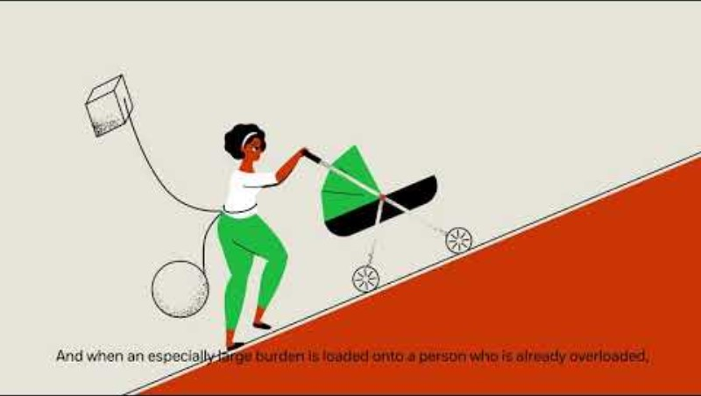
Environment and Intersectionality
This short NSPCC animation (1:06) provides an overview of the impact the environment we find ourselves in can impact on parenting capacity. It is taken from the sharing brain stories booklet

Slide 27

Environment and Intersectionality
1 Tackling the ‘normalisation of neglect’: Messages from child protection reviews in England (wiley.com)
2 Research in Practice supply a tool supporting legal literacy across social care and housing
Intersectionality invites professionals to consider how a person experiences the world and how these experiences inform their interactions with others and the extent that they feel able to share their lived realities. These experiences are shaped and influenced by aspects of a person’s identity, such as their ethnicity, age, gender, sexuality, class and abilities. Crenshaw (1991) noted that people’s interactions with the world are layered and multifaceted. It is essential that when working with people we are curious about their lived experiences across these layers, and that we consider the environment in which they live.
Neglect is often bound up with the prevalence of poverty and it is easy to become confused about ‘which is which’ and not address the right issue. Environmental circumstances can be overwhelming and can dominate perceptions, leaving a sense of continual busy-ness and blinding professionals to other forms of maltreatment that may be present [1]. Poverty may exist alongside other causal factors and can have psychological effects such as loss of self-esteem on the carer; it can also limit choices available to a carer.
Any response to these complex factors needs to be informed by those we are working alongside. John Burnham’s Social Graces is a useful tool that can be used to understand a person’s identity.
Consider responding to these complex factors by being curious about the circumstances. You may wish to consider carer responsibilities, families seeking asylum/migrant families, access to health and support services, both location and funding wise. Be aware of the impact that discrimination and abuse can have on people and the barriers this might present to families and how willing they may be to access support and services. Further learning about this is in the think family slide.
Any work we undertake can and should include addressing our own unconscious biases and challenging discrimination where we see it. This might include challenging normalised ideas within teams or services about certain families or circumstances too.
Professionals can identify and take prompt action where early warning signs relating to housing needs are apparent; such as rent arrears, other debts or borrowing, changes to the size of the household (with implications for housing benefit entitlement), unopened letters, and any escalation in other support needs such as mental health and substance abuse. This is likely to result in more families being able to stay together’[2]
Lincolnshire is made up of 7 Councils which all have unique characteristics and include urban, rural and coastal areas. Both aspects of rural and coastal makeup result in seasonal employment and this can also impact on access to services. Wages can be low and this impacts on affordability and therefore access to adequate housing. Transport links to many areas of the county are limited and can affect service provision and access to services or wider opportunities. Click on the image to be taken to the full demographics of Lincolnshire.
These factors can impact a child directly and indirectly and may be seen through the effects of material hardship, or through indirect effects of stress on a carer which can lead to poor quality care. A person’s ethnicity, age, gender, sexuality, class and ability can significantly impact how they experience the world, what housing, opportunities, and experiences are afforded to them, how they are treated or how they feel they will be treated by professionals.
Poor housing and living in overcrowded housing can contribute to health and developmental inequalities, including respiratory problems, stress, anxiety and depression; poor physical health, slow growth; and lower attainment at school due to missing school through illness and infection. People in overcrowded households are also more likely to indicate psychological distress.
Where environmental factors impact on a family, they can cause significant stress and worry and can lead to irregular or disturbed sleep, anxiety, and feelings of shame which can be extremely difficult to cope with.
Click the image
for resources

Slide 28
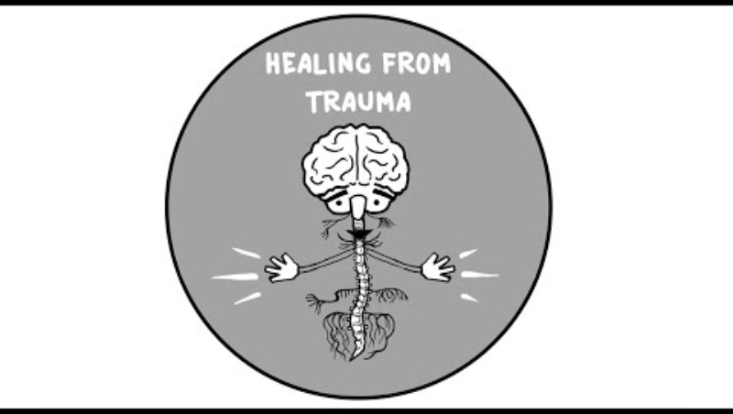
Trauma & Adversity
‘I believe in a fundamental and universal truth: Trauma blocks love and connection, and healing our wounds provides access to the love and goodness inherent in us all.’ Frank Anderson, 2021. Trauma experienced carers may find working with services and professionals as the high anxiety can often induce a stress/survival response.
Many common problems that come to the attention of children’s social care may be linked to trauma that a carer has experienced. Carers may not know they are affected by trauma or how it can impact parenting.
Understanding the brain and
the nervous system can help
practitioners to understand
the foundations of survival
reactions and trauma.
Watch this video to learn more.
(8:57)
Research in Practice state that there are six key principles of trauma-informed practice - Safety, Trustworthiness, Choice, Collaboration, Empowerment and Cultural consideration.
People may have experienced periods in their life where they have not been given control and agency over their decision making and their bodies. It is therefore particularly important to give people time to communicate their needs and help them problem solve to find solutions of how this can be achieved when meetings or assessments might be more difficult for them. More learning can be found in healing psychological trauma.
You might consider offering the carer chance to write things down or allow them to have someone present who can advocate and communicate thoughts they have shared beforehand. Offering periods of silence while they formulate their thoughts and emotions, providing them time to respond can help. Building up trusting relationships and actively listening to a carers experience is crucial in supporting them to feel safe.
Trauma can be triggered by a variety of things, and we should always be mindful of how a person reacts or responds to situations or information. Being professionally curious about what might be causing the response, or reaction can aid in understanding what is going on for the person. To support someone, we must understand their lived experience and how this is impacting on their capacity to parent.
Trauma is complex – take small steps to offer support. Ask, If there is only one thing, I can help you with right now - what would that be?
Due to the interconnection of trauma with mental health, development, relationships, and substance use, any presence of trauma can impact on child safety and development. Individual responses to trauma are likely to vary and may present through complex dynamics and a person’s learnt survival responses.
Adverse Childhood Experiences will impact on a person’s attachment and survival, this is likely to have long-lasting effects for a person and can impact relationships, with significant other, family, friends, professionals and their own child. Trauma can contribute to repeated patterns, such as, repeated pregnancies, removals, and substance use; all of these are likely to impact a child significantly.
In some very serious circumstances significant neglect occurs because of the “meaning of the child”. The child can have come to represent something negative or may trigger a carers past trauma, in these circumstances the carer blames the child for the neglectful care they are receiving. This can involve the child being ignored or even being targeted.
Click the image to read a case study which provides an example of working with trauma and an overview of how the worker responded to the parent’s need.
A
Click the image for
resources

Slide 29
Omission
or
Commission
It is essential that omission and commission are understood; they are both important in understanding the nature of the neglect and actions necessary to address this.
Neglect is often (but not always) a passive form of abuse. The definition from Working Together, refers to failures to undertake important parenting tasks, which are often referred to as acts of omission. Acts of omission mean a carer is not doing something that they should be doing for their child. There are dangers where neglect is seen as passive and resulting from the personal difficulties of adults. This can cause professionals to be overly focused on the needs of those adults and to lose sight of the needs and lived experience of the child. It is crucial that we understand the capacity of the carer in this situation to truly understand the cause of neglect. | There are also times when neglect is deliberate and targeted, often characterised by cruel, harsh and abusive parenting. Where a carer is deliberately or knowingly neglecting their child, this can be seen as an act of commission. In these circumstances, the child can sometimes be presented to the professional as the main concern; with carers presenting their child as the problem and the cause of the poor care they receive. This requires us to robustly challenge the negative views that carers hold about their children. There are times, for example, where adolescents may seem to be engaging in behaviour that puts them at risk or where children have very complex needs, where professionals can over identify with adults concerns and by association unintentionally collude. We should guard against being drawn into negative views of children and inadvertently colluding; instead, provide appropriate and firm challenge to this. It is crucial that we understand the motivation of the carer in this situation to truly understand the cause of neglect.
Ensuring any plans and interventions are meaningful and understood by the family is essential. To support with this SMART targets should be used in planning, to find out more see the SMART targets section, here.
Click this image to read the National Practitioner Briefing on Arthur & Star which highlights some of these themes.
C
Click this image to read a case study from Lincolnshire that highlights issues of omission and commission.

Slide 30
Co-existence with other forms of abuse
Child Neglect often co-exists with other forms of abuse. Emotional abuse is a fundamental aspect of children’s experiences of neglect. However other forms of harm such as physical abuse, sexual abuse, harm from exposure to domestic abuse and child exploitation can and do co-exist with neglect.
The existence of neglect should alert practitioners to exploring whether children are being exposed to other forms of abuse and to incorporate these findings into any assessment or plan.
Sexual Abuse
Exploitation
Neglect
Domestic Abuse
Physical Abuse
Emotional Abuse
Physical Abuse
Sexual Abuse
Think about a case you are working or have worked where other forms of abuse were present - was neglect identified after another form of abuse was? If so, why do you think that was/is the case?
Or
Are there any cases you can currently think of where neglect might also exist alongside another form of abuse – has this been considered? If so, how in-depth? As you go through this resource could the tools and information shared help to strengthen your direct work with the family on neglect?
Neglect
Exploitation
Click on the image below to be taken to a Case Study from Lincolnshire that provides an example of this co-existence
B

Slide 31
The word ‘Neglect’
It is important that the word neglect is used. Professionals need to be confident with identifying neglect and communicating it clearly and honestly to families as early as possible.
Neglect can be a scary word for carers to hear and for professionals to use. Neglect is complex and can be difficult for families to understand what it actually means. A carers understanding of this term may be formed from stereotypical examples of neglect and might not be something they understand is happening in their family. A child’s lived experience is likely to be common and part of their daily life, therefore they may not understand that what is happening to them is neglect. The word neglect is often not used early enough when working with families and this has led to confusion and challenge at Child Protection conferences where the category Neglect is used. As mentioned, we should be working openly and honestly with families, and this means naming neglect and the harm it is causing or has caused at the earliest point. This can be a challenge as we do not want to disengage families; however, it is important that when we identify and discuss neglect with families, that we communicate this accordingly to ensure they understand what this means. | We regularly have difficult and challenging conversations with families, it is these conversations that can have the biggest impact and make the most difference. It is essential that when working with neglect, we check with the family what this term means for them. We should have direct, clear discussions with family about the harm that a child is experiencing as a result of the neglect. How we address this and discuss this with families, can look different, we can label neglect and highlight this by phrasing our concerns thoughtfully, this might look like: “We are worried that if Charlie is not taken to their medical appointments that their medical needs are being neglected and this could have long-lasting implications on their development and health, which could include...” You can use the information in the Responding to Neglect section to support you with some of the complexities around labelling the type of neglect present.
Not naming what we see as neglect as early as possible and the impact it is having on the child’s development and safety, risks minimising and allowing the neglect to continue. When we use clear language, families and other professionals understand what we are concerned about. Using the term neglect allows other professionals to understand the picture, patterns in the lived experience of the child and allows us to respond accordingly across our agencies. Use of the term ensures we can portray the seriousness of the situation to the family and all other agencies. Neglect is on an equal footing with other categories of abuse and should be treated with the same level of seriousness. Naming this early on can also avoid a family hearing the term neglect for the first time in a formal meeting with other professionals, such as in a child protection conference. | Consider your feelings on the word neglect….are there barriers when using this term with families? If so, what are they? How can you overcome these? What barriers might the family face when discussing or understanding the word neglect? Neglect is what the child lives and knows, consider then, how a child might communicate their experiences of neglect when they have known or seen no other care. It is like asking a fish what it is like to live in water. Are there things that can be done as a team or within your service that can help to break down these barriers? A suggested task here is to have this discussion with colleagues in a team meeting or training session, or to discuss in supervision.

Slide 32
Responding to
Child Neglect

Slide 33
Identifying and Assessing Neglect
Are some children identified more routinely than
others? Who does not get identified and why do you
think this might be.
Responding to Neglect early is essential in stopping the harmful and cumulative impact. Where a case reaches Child Protection, it is likely that the neglect experienced by the child/ren will have caused significant harm and have a lasting impact. As soon as a concern is noticed or suspected, agencies should seek to respond to this concern immediately. This response can take many forms and may well come before an Early Help Assessment is agreed and developed. Universal services are likely to be routinely addressing concerns regarding early signs of the neglect of children and young people with parents and caregivers. If a single-agency response is required and consent is provided, the Early help Assessment can be used to structure these discussions and provide support using a strengths-based model.
Where consent is not provided, it is still important to document concerns following your organisational policy, to ensure that you build up a picture of what worries you have and the steps you have taken to support the family. This way, the history and cumulative picture can be captured, helpful support can be replicated, and the carers response to professional intervention can be understood.
If there are challenges with engaging families in the early help process, you can contact your Early Help Consultant for advice and support on asktac@lincolnshire.gov.uk
Monitoring a situation or family might feel like the best approach, but monitoring does not equate to action or change for the child. If the worries are significant enough to be monitored a conversation should be had with the carer.
You should regularly review any Early Help Assessments completed or records detailing concerns to ensure you are always assessing the current risk and picture. If there are challenges in engaging the family and you are concerned for the safety of the children, then you should make a safeguarding referral by following advice available here
To support with the identification and assessment of Neglect, LSCP have worked with partners to produce Lincolnshire Neglect Scales, accessible on the next page. The Early Help Assessment and other tools which can aid in identifying neglect can be found later in this section of the resource.

Slide 34
Introduction to Lincolnshire Child Neglect Scales
Child Neglect by carers is the most common form of child abuse. It is the most common reason for a child to be subject to an early help response, to be a child in need and to be subject to a child protection plan nationally and locally.Many families face difficulties that impair their capacity to meet the child/ren's needs, and to provide parenting that helps children develop and keeps them safe so that they feel loved and cared for. Addressing this serious issue for children and young people requires a robust evidence informed multi-agency response. We know from research that, by the time the threshold for child protection is met, children may have experienced neglect for several years, causing long term harm.
Lincolnshire Safeguarding Children’s Partnership has developed Neglect Scales alongside this resource in response to complexities that practitioners face in identifying, assessing, evidencing and responding to neglect. These Scales should be used alongside this resource and the guidance available on the following slides; the Scales have been developed to assist with the quality of assessments (EHA, CFA and others) where neglect is a feature. The Scales are separated into five areas of care:
These areas align to the areas highlighted in the earlier Types of Neglect section.
Each area provides an overview of examples where:
The language is designed to be used directly with families and should ensure a consistent shared language is used with families and professionals, this should also support with highlighting the impact of neglect and outlining aims for families.
After each area of care there is an analysis section which includes questions for you to consider with the carer to inform assessments, planning and reviews. Further guidance is available on analysis in the following section.
Physical | Health | Safety and Supervision | Love and Care | Stimulation and Education
All needs are met | Most essential needs are met | Most essential needs are unmet | Essential needs are entirely unmet/disregarded.
Download a word version of the
Neglect Scales by clicking here

Slide 35
Guidance on Lincolnshire Child Neglect Scales
When sharing these Scales with families,
Hold the impact on the child/children at the foremost of your thinking and curiosity
Please use them to guide your conversation, prompt questions and explore different areas of neglect (Types of neglect)
It will be important to build trust and warm relationships with family members, and to know what role each adult has in providing care for the child.
Do not complete them as a tick box or scoring exercise – use them to structure your assessment on areas of need
Think about who else can help with specific areas e.g. family network, Health Visitors, nursery or education setting
Think particularly about who knows the child best and can tell you about their lived experience and life
Consider when you can review the Scales and evidence any movement in thinking and behaviour
Use the Scales to strengthen your assessment, consider why the situation is as it is, what has changed this previously, what is impacting on the carer’s behaviours (sections in green text – Causal Factors and Omission or Commission)
How long has the issue been present? What is the culminative impact of this? (Persistence and Change)
How does neglect link with any other forms of abuse? (Co-existence)
What do you still need to know?
A frequency chart has been produced (below) to guide assessment and analysis – please use this as a guide alongside your professional judgement when considering the examples provided in the Scales, along with any additional behaviours you are seeing. This can be used to support building up a pattern and/or assessing risk and impact to the child.
Often / Usually | 6/7 days a week | 70% - 100% of the time | This is the norm More often than not
Sometimes / Frequently | 3/4/5 days a week | 30%-70% of the time | There is a more consistent pattern of repetition of behaviour Is happening about 50% of the time
Occasionally / Rarely | 1/2 days a week | 0% - 30% of the time | This is out of the ordinary / norm Not a consistent or dominant pattern of behaviour

Slide 36
Guidance on Lincolnshire Child Neglect Scales
After each area of care, you will be presented with an analysis section which asks several questions. This is designed to support your discussions with carers and to summarise any worries you have identified in that area, relating to neglect and the quality of parenting. These questions are consistent at each analysis point, you will find some additional guidance on these below, with context and practical examples. These are not an exhaustive list of things to consider but should act as additional context and support when considering any worries.
Question | Context | Example
What is working well and what are the worries? | Working in a strengths-based approach is key. The Scales utilise a colour code and provide a frequency chart which can be used to identify worries. These can also be used to produce realistic aims and goals and can measure change. | Working Well When considering Physical Care - ‘Child’s Clothing’ the child’s essential needs are met as identified in the yellow column – “I can see that your child is usually dressed appropriate for the weather conditions and that their clothes fit well and are clean.” Worries When considering Physical Care – ‘Food’ the child’s essential needs are unmet/disregarded as identified in the red column - “I am worried that your child does not get an adequate quantity of food and is often observed to be hungry”. You can use the colour coded column to create realistic targets and set out expectations for the carer/s. In this example, you could set a SMART target relating to food such as: Over the next 7 days the family will follow the meal plan we have created together, to ensure that the meals follow the agreed changes and can be made around everyone’s schedule. This will be reviewed at the next visit through observation and any adjustments can be made to the meal planner. After an agreed period of review for the family you can review this worry to see if there has been any positive change that could move this concern to amber or to no longer a concern.
Further details on SMART targets can be found later in the resource.

Slide 37
Guidance on Lincolnshire Child Neglect Scales
Question | Context | Example
Where would you scale any concerns on Signs of Safety? | Scaling can be useful in identifying what is working well and any risks. It can help with prioritising responses and actions and can demonstrate movement and impact of an intervention well. Scaling is useful when considering any worries in the context of frequency as well as the scale and nature of the worry and the impact on the child. | When considering ‘Safety and Supervision’ there are several concerns around this area for a family, including no safety equipment being used in the home and car, education around road safety has not been prioritised and there is evidence that there has been no improvement following previous interventions. The combination of these concerns should influence where you would scale this area of care using signs of safety. Using your professional judgement to understand immediate risk is key when considering this scaling question. Where one example is extremely high risk, i.e. in the care of dangerous adults this should be responded to individually as a high-risk concern. These worries should inform any danger statements and safety goals when using the Early Help Assessment. Both examples would constitute scaling low in relation to safety. It is crucial to consider accumulative impacts and responses from a carer when considering scaling, as well as considering individual factors which may evidence risk of imminent harm.
More details are provided later in this resource relating to the Early Help Assessment, including additional supportive documentation and training that is available in Lincolnshire.

Slide 38
Guidance on Lincolnshire Child Neglect Scales
Question | Context | Example
What is the carer/parents’ view? Do you agree? | We are working with parents/carers, and it is important to include their views. This can demonstrate their understanding of the situation, what their priorities are and can monitor engagement. This question provides an opportunity to confirm understanding and agree actions. Where disagreements occur, it can be useful to share how certain factors impact on the child. Where possible using the child’s voice and experience can influence these discussions. | When considering ‘Physical Care’ – Safer Sleeping for Babies there are worries that the carer has been given the relevant information on safe sleeping. Following repeated visits, you observe no evidence that this is being followed or that they wish to make a change. When you have asked for their view, they have disagreed with your assessment and shared that they don’t believe in the guidance. Recording all attempts to share information and promote change should be recorded in a chronology, along with instances where no action is taken by the carer and reasons for this. Asking for the parent/carers view and working alongside them can provide this information and can influence change. You should also record and share with the carer any other complicating factors that would increase risk for the baby, taking appropriate actions when required (see LSCP Safer Sleep for Infants Guidance).
Further support is available later in the resource on:
Working with Resistance
and
Chronologies

Slide 39
Guidance on Lincolnshire Child Neglect Scales
Question | Context | Example
What is the impact and/or potential impact on each child? | Considering each child’s needs, including, additional needs, unique factors and developmental milestones can provide more understanding around their lived experience and how neglect is impacting on them. Each child should be considered in the context of their own network. This can include exploring the family dynamics, living arrangements, and care provision. | When considering Physical Care – ‘Food’ - There are individual dietary requirements for a neurodiverse child within the family. As an example, this might include preferences around textures of food. If the carer continues to provide unsuitable food, the child may not eat and therefore this impacts on their health and would be a red concern. The other children in the family may be having their dietary requirements and preferences met, and there may be evidence of provision of a healthy balanced diet in the home, however in the context of considering this for each individual child the impact is different. Another example, might include: When considering Love and Care –’Positive values’ – The child has informed their parents of their sexual orientation which has resulted in derogatory and homophobic language and attitudes being directed at them. This is impacting on the child’s self-worth, identity and feelings of safety in the home. Where there are other children in the family these attitudes and values will be impacting on their understanding of the world and others and their feelings of safety in the home. Each child in this family will be impacted by this in different ways.
Consider the earlier section relating to the Impact on the Child.
Further support on gaining the Voice of the Child is available later in the resource.

Slide 40
Guidance on Lincolnshire Child Neglect Scales
Question | Context | Example
What are the personal circumstances preventing the parental care? | Think family, is there a recent change or loss? Is there a structural need such as housing? It could be that there are additional needs for a child that the carer has struggled to understand or adapt to. For some families there can be adversity or inequality that includes discrimination. The experiences of stress and hardship can impact on care provision and a carer’s ability to cope. For ‘parenting’ we mean anyone in a key caring role for the child, providing day to day care for basic needs. | When considering Physical Care – ‘Stability of housing’ – where there are concerns around home moves this should be understood in terms of the circumstances and impacts that may affect care. Moves can happen for a variety of reasons from unstable and short-term housing that could also be linked to economic instability, that may lead to unplanned moves, temporary accommodation that is inappropriate and/or potential education gaps. This is impacting on the child and causing stress for the carer. Home moves might also exist as a result of being in the forces, where there may be more systems and planning in place to manage the impact on the family. Whilst the stability of housing is affected in both of these examples, the impact will differ due to the reasons, personal circumstances and planning in place. Considering the wider context in these examples along with any mitigating factors that are in place to minimise the impact on a child and support the family with a move, alongside those circumstances that cause the move and compound the issue are essential when making an analysis. The LCSP Transient Families Policy may be useful to consider when working with families that move frequently.
Further support is provided later in the resource on how to ‘Think Family’.
You might also find the ‘Responding to Environment and Intersectionality’ section helpful.

Slide 41
Guidance on Lincolnshire Child Neglect Scales
Question | Context | Example
What are the factors impacting the carer? | Causal factors are those that have been identified as having a causal link to neglect, directly related to the carer. Any identification of a casual factor and analysis of caregiving must take into account the lived experience of the child and the motivation and capacity of the carer to support and protect the child. It is important to note these casual factors can be interlinked and may also appear with any of the other stresses such as personal circumstances of change, loss or adversity such as poverty or discrimination. | Whilst acknowledging that a causal factor is impacting on the carer, it is essential to then consider what impact this is having on the child. Where an identified causal factor is substance use, you might find this impacts on several areas of care. When considering substance use and Love and Care – ‘Warmth and Care (including for unborn babies)’, there are concerns about a carer’s inconsistent responses to the child. The child reports changes in responses from caring and kind to scary, angry and upsetting. This directly impacts the care provided to the child which makes them feel unsafe and is likely to impact on their attachment (NSPCC provide details around attachment and child development). In respect of ‘positive values’, the child needs to be provided with role modelling regarding their emotional regulation and the actions of the care giver who has problematic substance use may reduce the quality of this interaction causing a child to miss vital cues regarding their own needs and emotions. The use of substances may also impact on an ability to provide appropriate ‘physical care’, for instance decisions around co-sleeping and/or neglecting the child’s hygiene needs. It could also impact on ‘Safety and Supervision’, for instance the child being around unsafe adults or being left unsupervised.
Details on Causal Factors are located earlier in the resource. Each identified causal factor links to an area later in the resource that supports with responding to the individual causal factor.

Slide 42
Guidance on Lincolnshire Child Neglect Scales
Question | Context | Example
What needs to happen next? | Determining circumstances, causal factors, impacts on the child and what strengths are present will assist you in deciding what will happen next. This may be at the point of formulating the initial plan or at a review point. Where an incident has occurred or there is concern around immediate harm, the next steps will follow escalation and safeguarding processes. | Individual responses to neglect will depend on a significant number of things. This resource and the Scales have been designed to support professionals to respond in a strengths-based approach, considering the individual needs of the family, and the child’s voice. Therefore, this should be considered alongside and tools and resources provided later in this resource. The six key areas of understanding neglect will help in formulating any plan. The impact and experience of the child should be held central in deciding what needs to happen next.
Further support is provided later in the resource on:
Planning an Intervention
Capacity to change
Reviewing a Plan

Slide 43
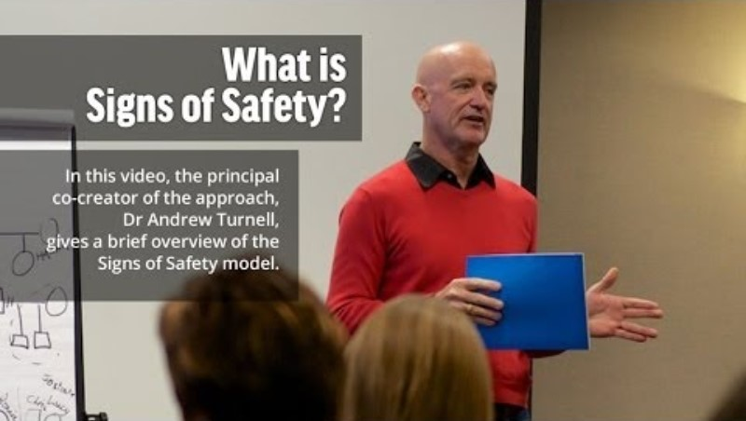
Early Help Assessment (EHA)
Where neglect is identified, professionals should consider the risks to the child, and if appropriate to do so, complete an early help assessment with the family to gain a full picture of the child’s lived experience.
Identifying and talking about neglect can be daunting, especially if this is a new experience for you or you are unsure about how to start the conversation. Using the EHA as a tool for discussion will help you to explore and understand: What life is like for the child/ren What needs to change for everyone to no longer be worried and What support is needed for the child/ren and family
Asking the right questions at the right time will help you in understanding the family situation. Using the language the child and family understand is key. Professional jargon, although commonplace for us as professionals, may alienate families. Keep the language simple and don’t be afraid to say what you see, as this will enable the family to relate to the worries you have.
The assessment is a working document and not a one-off assessment so this can be changed and updated if you are gaining the picture over several visits or conversations.
The EHA and all supporting processes are aligned to the Signs of Safety model which is explained in this video (2:59).

Slide 44
Early Help Assessment
Here are some important things to remember when using an early help assessment.
An EHA should always be completed with child, young person and family. | An EHA should only be completed with consent. | It is strengths-based and provides opportunities to identify, using evidence, what is working well. | An EHA should always use language that the child and family understand. | It is a holistic assessment that should include what life looks like for the child at home, as well as in the setting in which you know them.
To encourage sustainable and long-lasting change a support network should be identified and included to support the plan. | If support is requested from the Early Help team, then a clear request on the assessment about how this additional support can meet the unmet need. | Relationships with the family are key. | It is restorative in its approach working “with” the family. | The EHA should be used as a tool to aid conversations.
Best questions to ask What or who is making this situation harder for you right now? What does a good day or bad day look like and what does it look like for your child? What do you think needs to happen? where do you need the support? Describe the parent you want to be. | The Early Help Pathway aids in identifying when a worry would lead to an Early Help Assessment and TAC. Click on this image to locate the pathway.

Slide 45



Early Help Assessment
Identifying the Support Network that exists for the child and family is central when thinking about the skills and knowledge that already exists and how this network can be utilised for best effect.
The network can be made up of family or friends or whoever the child and family feel offers them support. The network will ideally be supporting the family long term, so it is important that they are involved at the point of assessment and included in the planning moving forward.
Who can support?
Opening to Team Around the Child (TAC) is a voluntary process, however the benefits this multi-agency approach brings is key in creating a plan which the family lead on.
There should be clear worries and goals identified with SMART (specific, measurable, achievable, realistic and timely) actions that include all of the identified network, including the professionals.
Being chosen to be the Lead Professional on a TAC is a privilege as the family have chosen you as the trusted professional to be their point of contact and to assist with the creation of their plan. Support for lead professionals can be accessed via the Early help Consultants. More details are available on the following slide.

Slide 46
Early Help Assessment
Using your professional curiosity is key in exploring what the situation is like for the family; you may wish to find out about:
the carer’s background, medical history and current circumstances
the parent’s thoughts and feelings about caring for their child
the views of colleagues from other agencies who are involved with the family
the child's thoughts and feelings
the impact of everyday parenting on the parent or carer’s mental health
the parent or carer’s ability to meet the child’s needs
whether the child has taken on a caring role
You should also consider broader factors that might make it harder for the carer to cope - such as any causal factors highlighted earlier in this resource.
Although you may be worried about the child and family, it is important to acknowledge the things that are going well.
Focusing on these strengths will allow for reflection on the good things and how these can be built on to support the outcomes for the child and family.
Some questions that may support with finding this out might include:
Thinking about a time when you felt you were the best parent you could be, what did this look like?
How can we support you to get back there now?
For more advice and support on Professional
Curiosity, click this image to access the
Professional Curiosity Resource Pack
To watch a video highlighting some barriers to professional curiosity, click here
What would the child/children say you do well that makes them know they are loved and cared for?

Slide 47
Early Help Assessment Support
There is a large amount of support available to all practitioners on the Early Help
process, which includes:
Early Help Consultants The Early Help Consultant team can support all professionals with any questions about early help. This might include questions around the assessment, acting as a lead professional at TAC, starting conversations with families, the best ways to identify support networks, advice on where to go next. The consultants will welcome all questions relating to Early Help and wider concerns or worries you might have about a family. The support is free and can be accessed by emailing the team on asktac@lincolnshire.gov.uk | Workshops, Forums and Training The Consultants also facilitate free workshops which can be accessed on the LSCP’s training platform Enable. These include: Training is also available which covers Early Help in depth within the ‘Inter-Agency Safeguarding Children and Young People’ course on the LSCP 6-Year Safeguarding Children pathway. Details on the Enable platform can be found here: How to Use Enable
Supportive Documentation The Early Help Assessment document and other resources such as the TAC Handbook, guidance on having conversations in Early Help, leaflets for parents and examples of best questions can be located by clicking on this image
Signs of Safety/Early Help Assessment | TAC Safety Planning
TAC Family Networking | Multi-Agency Forums
The following section highlights key resources, tools and approaches which will support practitioners to complete an early help assessment with the family

Slide 48
Capacity to change
Practitioners need to be particularly skilled in engaging and working with parents and carers whom services have found difficult to engage. Some examples may be parents and carers of disabled children, parents, and carers whose children are at risk of, or experiencing, harm from outside the home, fathers, and male carers, and those who are neurodivergent. Working together 2023
An essential part of any assessment process is evaluating the carer's ability and motivation to change.
For change to occur carers need to accept that change is necessary and agree what that change should be as well as engaging with support and interventions aimed at facilitating change and then maintaining it with a demonstrable effect on the child’s outcomes and needs.
A carer must understand why a change is needed to act, clear and honest communication is key here. This includes regularly checking a carers understanding when worries are communicated and that any actions identified are clearly understood and realistic.
Capacity to change should be considered at an early point and regularly throughout the work you undertake.
If carers do not accept there is a need for change, it will not happen, even if they attend appointments and interventions. Sometimes carers may say that they accept the need for change and agree what change should occur, but do not engage with support or interventions consistently.
Carers may take a dismissive approach to childcare responsibilities, or they might not see the child as their responsibility. They might consider any harm that the child experiences is the child’s fault, they might also believe the child deserves it.
In considering capacity to change, we need to understand a carers lived experiences to understand their approach to parenting. This should include being trauma informed in our approach. We should not assume that the advice and support we offer is understood or accepted as the right approach by the carer.
We should also consider the meaning of the child to that carer as highlighted in the trauma section.
Professionals should note evidence of changes and improvements made as a result of previous interventions and the impact of this for the child.
Tools within this section can support in evaluating a carers capacity to change. These include the Early Help Assessment and Chronologies.

Slide 49
Capacity to change
Think about a family you are currently working with and consider where they are on the cycle of change.
Has the carer accepted a change is needed?
Does the carer have the capacity to change?
Where there are relapses are things still changing for the child?
If not….think about what is needed to create change or what work can be carried out with the carer to support them to understand the need for change.
As outlined previously, this could be complex so you could discuss this with your colleagues, a designated safeguarding lead or as part of supervision, group supervision or a case related training exercise.

Slide 50
Neglect and the Criminal Justice System
The Children and Young Persons Act 1933 Section 1 states that an offence occurs where:
a person who has attained the age of sixteen years;
who has responsibility for any child or young person under that age; willfully (i.e. intentionally or recklessly);
assaults, ill-treats (whether physically or otherwise), neglects, abandons or exposes him, or causes or procures him to be assaulted, ill-treated (whether physically or otherwise), neglected, abandoned, or exposed;
in a manner likely to cause him unnecessary suffering or injury to health (whether the suffering or injury is of a physical or a psychological nature).
This Act has been updated and modernised by the Serious Crime Act 2015 Section 66, by making it explicit that the offence applies regardless of whether the suffering or injury caused to a child was physical or psychological in nature (which was already implicit).
It is important to intervening early and effectively to support families so that the criminal threshold is not met. Professionals need to ensure that children are not subjected to neglect and seek to ensure that families are not criminalised, where possible. However, in the most serious cases a criminal justice response is required.
Professionals should take steps to ensure that evidence is preserved that may support a future conviction throughout their work with children and families. Police should support professionals to understand the criminal threshold for neglect and must respond in a timely, coordinated way with other professionals to pursue successful prosecution.
Considering the importance of record keeping in identifying neglect and for potential prosecution how might your agency keep accurate records of key events, discussions, and observations?
You may wish to consider the examples and questions provided on the next slide to support with this task. Some of these questions might feel uncomfortable, so consider what approach you would take in these instances. Some areas you are asking about are going to feel uncomfortable, remember the earlier section on ‘The Word ‘Neglect’’ . Asking about nutrition or reasons for non-attendance might stir up similar feelings – consider why this might be…

Slide 51
Professional curiosity
and record keeping
Using your professional curiosity is also key to exploring a carer’s motivation. Asking questions and good record keeping of responses can be used to evidence where a carer consistently fails to respond to advice or support, which results in continued neglect for a child. These records can aid conversations with a family and provide evidence of concerns; they can also be used as evidence where criminal charges are appropriate and can demonstrate evidence of wilful neglect or neglect through recklessness. Look at the examples below to see how professional curiosity might be used and what to record.
Poor Nutrition | School Attendance | Child not Brought to Appointments | Failure to Seek Medical Care
You may have spent time advising a family on nutrition and healthy eating; however, you may continue to have concerns if you notice unhealthy food during visits or within a child’s lunchbox. Ask why this is the case. You might be told that it was only a one off. make an observation about whether it looks like meals are being prepared or if there is healthy food in the fridge or cupboards, for instance. ask about meal planning and budgets to identify if there is a cause or consider if this might be an example of advice not being followed Record these conversations and observations. Record the advice provided and any responses to this. This can evidence continued failure to respond, despite the carer being provided with advice and support. | You may notice that a child has repeated dental appointments and is being brought late to school or missing school for these. You may also notice that the child’s dental hygiene is poor. You can ask the child about the appointment/s, what time was it, how did they get there. They might not be able to explain what a dentist appointment is. Ask the carer similar questions about where the dentist is and what the appointments are for. The responses may bring to light further concerns about the child’s care; you should address this accordingly with the family. Record the child and carers responses to evidence the circumstances and what you are being told. | You might notice repeated episodes of a child not being brought to appointments. Keep a record of this and any reasons for the non-attendance. You should explain the importance of the appointment to the carer and any impact missing the appointment might have on the child. You might notice a pattern of repeated excuses, such as a car breaking down or delayed transport. Ask questions: Has the car been fixed, ask for more detail around what occurred as it may become important later Do they have a recovery plan for future? Did they manage to get to where they needed to go that day? Is there alternative travel they can identify for future? Record all of this to build up patterns, responses and detailed information about what a carer might have considered as a plan for future. | Where a carer fails to seek medical care for an unwell child or for injuries. You can enquire about what the carer might do if they were unwell or injured. If they recognise, they need or should seek medical care, then you can advise that this applies to a child too. If this conversation and understanding is recorded, this can be drawn on later if the child’s medical needs continue to be neglected. Where a pattern is built up and reasons provided by a carer you can ask for more detail (similar to those questions in the ‘not brought to appointments’ column).

Slide 52
Planning an Intervention
When using the Neglect Scales practitioners are prompted to consider a range of questions after each ‘Area of Care’. These questions should highlight the level of risk and should inform the response and plan. Where an immediate safeguarding concern is identified, then a safeguarding referral should be made.
Multi-agency plans should be in place for children who are in need or vulnerable as a result of neglect.
Plans should be in place whatever level of service or intervention is being offered, and whether it is a single or a multi-agency intervention, known as Team Around Child (TAC).
The plan should be drawn up with the family, including the child wherever possible, together with any other agencies involved.
Disagreements about the level of concern or interventions to be offered must always be addressed and resolved with the child's needs as the central factor.
Professional disagreements can derail intervention designed to improve circumstances, if at any stage there are concerns about how another professional or service are responding, please follow the Professional Resolution and Escalation Protocol to resolve these in a supportive and timely manner.
Interventions are more likely to succeed if they are multi-faceted, tackling multiple risk factors. Packages of care may include a combination of interventions addressing a range of needs, such as mental health issues, domestic abuse, substance misuse.
Given these complexities, plans should be sequenced in line with priorities and what is realistic to achieve, in relation to risk. SMART targets and goals should be agreed upon. Strong coordination is required to move forward and therefore a multi-agency approach should be utilised. Appropriate services, professionals and/or family networks should be clearly named, with certain aspects of a plan aligned to the most relevant services or people who can provide the support required.
There should be clear timescales set, and regular reviews planned to focus on what is changing for the child. Where possible, outcomes should be identified in terms of behaviours and should include how the anticipated changes will help the children develop and reach their potential.
You should outline what will happen should things not change to ensure you are working in an open and honest way. This should include providing evidence and examples of what needs to change to demonstrate progress, so that it is clear what needs to happen for the family.
Working cooperatively with families in this way is more likely to encourage and create sustainable change.
Small, practical steps can be identified to appropriately sequence a plan. Change can be measured in the short term to avoid drift and delay. Examples might include:
clearing small areas of a home environment and setting clear timeframes on this action, such as by the next visit, rather than the family moving to a bigger property to gain space.
supporting the carer to take the first step in moving forward with a problem by supporting them to contact a support service.
These steps can easily be evidenced, and successes can help to build confidence with the family.

Slide 53
Planning an Intervention
Outside of the logistics of creating a plan with the family, there are some wider considerations to make that should inform any intervention.
Neglect is often chronic in nature, involving a complex interplay of entrenched family difficulties. There is not likely to be a ‘quick fix’ remedy available. Services working with these families may need to work with some families on a long-term basis.
When carers experience attachment difficulties in relationships, it is likely that they may also experience difficulties in their relationships with agencies that are attempting to intervene. Carer’s feelings of mistrust and of being blamed can reduce the success of an intervention, and such feelings are often present where neglect exists.
Professionals will likely need to consider how to build effective and trusting working relationships with families in challenging circumstances. To do this, a trauma informed approach should be taken to ensure that we work empathically, respectfully, and in partnership with families, rather than being seen as doing things to families.
Children who are neglected are often isolated within the community, by their peers and sometimes within their own families. Plans for children should consider ways in which they would like to become involved in activities to reduce their experience of isolation.
To reduce risks, plans for children who have been neglected need to address the process of building resilience. Building resilience might include linking a child with leisure or community services, school-based activities or connecting the child with a safe adult or friend who might be willing to spend time doing activities with them.
Further considerations should also be made to the learning needs and styles of the carer to ensure that what is being offered to them is suitable and understood.
Consider whether the service you are proposing or providing is empowering a family, or whether it is contributing to feelings of dependency.
Think specifically about how each child is included in the plan – does the child need help and support to improve their self-esteem, build resilience or cope with some aspect of their lives, for instance.
Consider any needs that remain un-met and whether this will undermine the carers capacity for change. There may be a need to involve adult orientated services if this is the case.
Try to ensure that the plans are coordinated and agreed across services so that the family experiences clarity and consistency about the required changes.

Slide 54
Planning and intervention Think Family
Professionals should always be thinking about what might be going on for a family which might be impacting on a child’s life. When working with families, the whole family and wider family network should be considered in relation to who/what can support to keep the child safe. Click left to right below to find resources that can support.
Think Family
General resources and support
If a child has been impacted by a family member who has been or is in custody Lincolnshire Action Trust (LAT) can support. LAT also focus on females at risk of or involved in the criminal justice system or complex issues, through the Women’s RISE Project.
This short video highlighting the Lincolnshire women's strategy provides additional information. ​
Families may need help with bereavement, support from their GP might be beneficial or local counselling services, such as LCGL.
For those effected by suicide, the Zero Suicide Alliance and AMPARO websites are helpful.
There is Suicide Awareness training available via the LSCP training site.
Please help the family to access Lincolnshire's family directory, Connect to Support Lincolnshire | Lincolnshire & LPCF Home (lincspcf.org.uk)​
The LSCP resources site includes resources relating to Family Networks in the ‘Family networks and Family Network Support Packages’ area.
You should always consider who in the family network can make a difference to a child’s life. Direct engagement with male carers and paternal networks, should also be considered.
There are additional resources and tools available here
Essential reading on this topic can be found in stable homes built on love
The Criminal Justice System
Bereavement and/or Suicide
Caring Responsibilities
Consider if anyone is a carer in the family. Support for carers is a useful site which provides information and support for both adult and young carers.
You might also find the below helpful:
LSCP Policy to support Young Carers and their families
Reducing Barriers and improving support for young carers (short video)
Young carers rights explained
Lincolnshire connect page for carers
If there is risk of homelessness there is a duty to refer to a local housing authority. Please read the Homelessness-Duty to refer policy
Further information can be found in the Lincolnshire Homelessness and Rough Sleeper Strategy
If there are concerns about parental conflict these best questions might be useful to consider (These are only advisable where it is clear there is no abuse present).
There is training available on understanding healthy parental relationships and recognising and reducing parental conflict via the LSCP 6-Year Safeguarding Children Training Pathway.
This Parental Relationship Spectrum may also be useful to consider.
The LSCP Separated Parents Policy is useful to consider.
Housing needs
Parental conflict
and/or separating/separated families
Information on Benefits and financial support to families may be useful.
Access to Work can support anyone with a physical or mental health condition or disability
Looking for work support is also useful to consider
Employment support

Slide 55
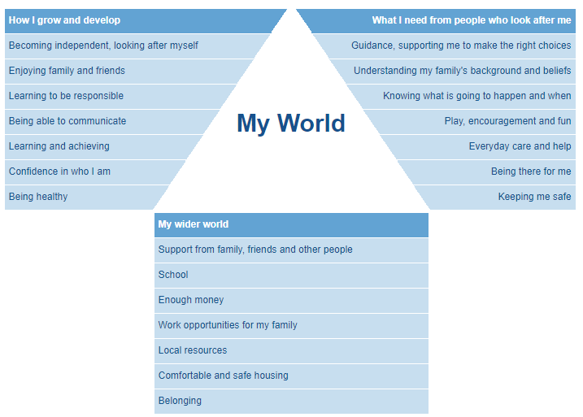
Planning an Intervention
This integrated assessment framework centred around the child’s world can support professionals to understand the full picture and communicate this to families. It focuses on:
The child's developmental needs
The caregivers' capacities to respond appropriately
The wider family and environmental factors
Any child's development is significantly shaped by both their experiences and the interaction between a series of factors. Some factors like genetic inheritance or temperament are often thought to be intrinsic to individual children. Others, like health problems or an impairment, may be a mixture of intrinsic and circumstantial.
Meanwhile others may relate primarily to a child's culture, and to the physical and emotional environment in which they live.
Look at the example timeline developed here to explore how the triangle works in practice The Assessment Triangle – Mairi's Life - Timeline (iriss.org.uk)
Think of a family or child who you are working with. Click on each section of the assessment triangle by clicking on the image opposite; consider how this might inform your assessment and any interventions.

Slide 56
SMART planning
The EHA and any safety plan should include SMART goals, actions and targets.
S | M | A | R | T
Specific | Measurable | Attainable | Relevant | Timely
Any identified goal, action or target should be specific and simple. This is also important in addressing worries, ensuring behaviours are identified and specific information is recorded in the plan. This approach ensures everyone understands what is being asked and what is needed to move forward or to enhance existing strengths. | The language used can ensure a target, goal or action is measurable. Using words such as, increase, decrease, reduce or maintain, can be helpful. When agreeing an increase or decrease, it is helpful to specify exactly how much by and to be specific with timelines, such as within a week or by a certain date. You can also measure targets by being specific about who/ what will evidence change and you can use phrases such as ‘will have or will not have done something’ to measure progress. | Information on the plan should be realistic and understood and accepted by all. Any targets, goals, or safety measures must be possible to achievable, in the circumstances and by the family you are working with. You can also think about sequencing here and break down some of the assessment, addressing the order of steps and approaches to be taken to ensure the plan | The plan should be relevant and meaningful to the family. The detail specified and agreed within it should mean something that improves the family's life, the outcome for the child, and addresses safety. There should be relevance of the target to the assessment findings, i.e., nothing new in the plan that is not already identified. | Any agreed goal, target or action should be understood in the context of circumstances and capacity. Therefore, they should be reasonable to expect in the time specified. With any issues that need addressing first, being prioritised. Timelines for targets should be appropriate and specific in nature, having reference to a certain date, event, or time of day, for example: morning, night, each day.
Click here to explore a case study which includes an example of how SMART targets can be used.
Consider a plan you have in place with a family right now. Are the targets, goals and actions SMART? If not, can these be updated with the family?
Consider what wording might need to be changed or whether there is room for additional SMART actions that could promote change.
A

Slide 57
Reviewing a plan
Circumstances and situations change regularly for families. The initial plan made together will need to be reviewed at regular intervals to ensure change is happening for the child, risk is consistently managed, and the family feel supported.
A review can be held with the carer and child (where appropriate) if there is a change of circumstances or an event that suggests the plan needs to be changed in any way; as well as at agreed intervals to monitor progress.
Progress should be closely monitored and lack of engagement in services by family members challenged. Progress will result in change for the child and an observable improvement in their outcomes, not just attendance at services by family members.
During the initial planning, a conversation should have taken place regarding what might happen if things do not change. Targets and actions should be agreed following SMART planning, and it should be clear where outcomes have not been met.
If there is no evidence of progress at a review and things are not changing for the child you will need to take action to address this, as initially discussed with the family, and following the relevant escalation processes.
It may be that further assessments are required if there are new or ongoing concerns about a child.
The EHA is a live document which can be reviewed and added to at any time.
Reviews at key transitional periods are extremely important. For instance, where Child in Need or Child Protection involvement ends, and the family is being supported by TAC or a single agency. Plans should be formally passed over and agreed, this includes Safety plans.
Safety plans belong to a family, not a single agency or practitioner; therefore, all professionals involved at any time should be aware of what safety measures are identified on the plan, so that these can be considered and understood by those working alongside the family.
If a safety plan or any plan is mentioned and you have not had sight of this, you must ask to see this so you can consider if it is still appropriate, given the current circumstances and support in place. You can find resources and support on safety planning in the early help section of the LSCP resources area.
When reviewing progress you should consider the following:
Are things changing for the child? | Has the carer taken on the concerns?
Do interventions need to be adapted? | Has there been a situation or relationship change and what does this mean for the child?
Is the safety plan still relevant? | Do additional measures need to be considered to keep people safe?
Click here to read an LSCP learning bulletin that highlights the
importance of reviewing circumstances, safety plans and information sharing.

Slide 58
Working with resistance
There can be a wide range of uncooperative behaviour by families towards professionals.
From time to time all agencies will encounter families whose compliance is apparent rather than genuine, or who are more obviously reluctant, resistant or sometimes angry or hostile to their approaches.
In extreme cases, professionals can experience intimidation, abuse, threats of violence and actual violence. The child's welfare should always remain paramount and where professionals are too scared to confront the family, they must consider what life is like for a child in the family.
There are a variety of reasons why some families may be uncooperative with professionals, including the fact that they:
A range of social, cultural and psychological factors influence the behaviour of parents. The more uncooperative the family, the more likely it is that the main influences are psychological.
In general, a parent will try to regain control over their lives, but they may be overwhelmed by pain, depression, anxiety and guilt resulting from earlier losses in their lives. Paradoxically, the uncooperativeness may be the moment at which the person opens up their feelings, albeit negative ones, at the prospect of help. They are unlikely to be aware of this process going on.
There are several types of uncooperativeness, including the below.
To read more about each read
‘Recognising Disguised Compliance and Disengagement Among Families: Practice Guidance’
Do not want their privacy invaded | Have something to hide
Have difficulty in accepting there is a problem | Resent/struggle with outside interference
Have cultural differences | Resent/struggle with staff changes
Lack understanding about what is being expected of them | Have poor previous experience of professional involvement
Dislike or fear of authority figures | Fear their children will be taken away
Fear being judged to be poor parents because of substance misuse, mental health problems. | Feel they have nothing to lose (e.g., where the children have already been removed).
Ambivalence
Avoidance
Confrontation
Disguised Compliance
Violence

Slide 59


Working with resistance
To understand the reasons behind any resistance, professionals should try to work with the carer and wider family to understand what is causing this response.
Watch this short video (3:18) on working with resistance to understand this further.
Motivational Interviewing can be used to ensure that we are working with a family and understanding their experiences and ideas for moving forward.
Watch this short video (2:07) which explains motivational interviewing and the benefits of working with families to empower them and encourage sustainable change.
Consider the advice provided in these videos and think about what phrases, words, responses, or questions you might prepare to challenge families in a constructive, helpful and supportive way.
When faced with resistance and challenge how might you asses the risk of the situation for the child?
How might you work in a trauma informed way to understand resistance or challenge? How might you work with the carer or family to understand more and move forward?
Are there other services that the carer might engage with, for instance?
You might want to discuss these in supervision or as part of a team meeting or training session.
The Professional Curiosity Resource Pack can be used to support practitioners with how to engage and work with families in a professionally curious way.
There is a 1-day LSCP face to face course titled ‘Recognise Disguised Compliance and Disengagement with Families’ available to complete via Enable. Full details on training can be found on the LSCP Training Page.

Slide 60
Barriers
Different services will face different barriers when working with children experiencing neglect. Please see the examples below which present ideas that might help to overcome these barriers or think differently.
Home environment | Limited time | Hidden Children
Not all services will be able to visit or complete work in the home. This may feel like a limitation in understanding what life is really like for the child. Professionals can complete a range of work with the child to understand what their home life is like. The LSCP resource section of the manual holds some tools to understand the child’s lived experience in the ‘Family networks and Family Network Support Packages’ area. Where concerns in relation to neglect exist, it is crucial to work with other agencies to understand elements of a child’s life that you may not see in your role. Information sharing is key and where professionals have concerns about neglect you should be confident that sharing or asking for information from other agencies will help to build the bigger picture and could be crucial in highlighting the accumulative nature of neglect. The LSCP Protocol on sharing Information in Order to Safeguard and Promote the Welfare of Children can be found here. | Some services, including health and the police, may see a family for a short amount of time or might not be able to undertake planned work with the family. This may feel like a limitation in understanding what life is like for the child. Professionals should use observations of the child/carer who is present. This can include, the child and/or carers appearance, interaction between child and carer, interaction with professionals, responses to questions and or information that is shared with the carer and/or child. Where professionals can observe the home environment, consider what it might be like for the child to use this space. The clutter scales can help make judgements on safety and developmental need. Professionals can also observe if the home environment meets the child's needs across all types of neglect. Where available, look at any past records or notes – try not to view this one interaction in isolation. Where access allows make attempts to review any history which might help in building up a pattern. Every interaction should be seen as a possible intervention. | Some services may become concerned that a child is not registered with a school, in this instance professionals should email CEM@lincolnshire.gov.uk There may be concerns that a child is not receiving appropriate education, which might include: Children excluded on a permanent basis for whom appropriate alternative provision has not been arranged, including those struggling to attend alternative provision or those on a reduced timetable Children who are home educated, but may not be receiving effective, efficient, or any education In these instances, children may be invisible, at risk, or their needs may not be met, because: Permanently excluded children are more at risk of exploitation, There is no requirement for carers to let the Local Authority (LA) know they are Electively Home Educating (EHE) Special Educational Needs and Disabilities (SEND) may be diagnosed historically and may or may not be shared by a parent with the EHE team. If at any time professionals identify a child who: is at risk of exploitation they should follow safeguarding processes if there is a risk of immediate harm and should refer to the Multi Agency Child Exploitation process is in EHE with SEND they should check that the EHE team is aware by emailing EHE@lincolnshire.gov.uk Professionals should be curious about all children in the family, particularly if the family is large or have different care giving arrangements, for instance living across different households; some children may be seen by professionals whereas others may not. If neglect is a concern for a child, other children in the family should be considered, including any under 5’s who may not attend nurseries – links should be made with health visitors and appropriate early years teams.

Slide 61



Tools and Resources
This section of the resource outlines how we in Lincolnshire can respond to Neglect when it has been identified.
You will find a range of resources here that can support practitioners to unravel the complexities associated with neglect, including:
Tools to support your direct
work and assessments
Support and resources focusing on individual causal factors identified earlier on in the resource.
Support and resources focusing on abuse that co-exists with neglect.
These tools and resources can be used within direct practice, so consider how they could assist with your current cases or future practice.
It might also be useful as part of group training or supervision to focus on these tools to enhance professional practice. Consider how these tools currently inform practice and whether there are developmental steps that can be taken within teams to enhance this work. For instance, if chronology work is chosen as a focus, you could ask staff to share their own experiences of chronologies or discuss cases where a chronology would be useful; consider the key concepts of the recommended tools and resources and work to explore how these tools can be utilised in practice to identify neglect, map patterns and provide a clearer picture of life for the child.

Slide 62

Voice of the Child
The child's voice is paramount and should be at the heart of everything we do. The 'voice' does not just mean what the child is saying verbally, but also what is seen through observation; for example, what is their behaviour telling you, their interactions with family and friends and any changes in presentation.
Children should be seen on their own in a comfortable setting to them. It is important to use age and interest appropriate tools, games and other methods to communicate. Gaining an understanding of the child’s voice and what their every day life is like is important because neglect is less about an event or an incident but about the daily lived experience of a child. Professionals should seek to understand what the child’s experience of being parented feels like, and the impact this may have on them. The child’s voice should also be sought from other professionals who are working with the child as this might be different to what they are telling you or what you are observing.
Professionals should be aware of all the ways in which a child’s voice can be expressed and communicated; especially when working with babies, pre-verbal children and children with disabilities. Remember the signs of neglect and consider whether a child may be communicating something through behaviour.
The first step is to gain the voice of the child, and the next step is to do something meaningful with it. Consider how the information you have gathered will inform the plan and create change. You may wish to consider:
What does the child want to see happen which will be meaningful for them?
Is there anything about change which might be scary for them?
Are we listening to what their voice or behaviour is telling us
How does the child want us to support the family to create and sustain change?
How this information will be communicated to the carer; how does the child want you to do this? Can you share their voice directly with the carer or other professionals?
There are a range of tools and resources available to support us with obtaining the voice of the child, click on the image below for some examples.
It is important that we are creative in our approach to this by working with the child and adapting to their wishes and feelings.
To read the NSPCC report ‘The voice of the child:
learning from case reviews’
Voice of the child training is available as part of the LSCP six-year safeguarding children pathway, accessible here
The Early Help Consultants can also support with this and deliver workshops to practitioners on this.
Click here

Slide 63
Chronologies
Given the cumulative nature of neglect and the length of time at which it can occur it is essential practitioners build up a picture of this. Building a chronology of events should be carried out during assessment or re-assessment and should consider the family’s history.
A chronology is a key part of any assessment and assists the process of care planning and reviewing. It is used to record significant events to help professionals understand what is happening in the life of a child. A chronology can provide a better understanding of the immediate and cumulative impact of events.
Developing and analyzing chronologies is essential to help identify patterns of behaviour, risk or concerns that may be preventing a child from achieving positive outcomes. Patterns in social history and behaviour can be detected and something which might appear insignificant in isolation can be identified as a key warning sign in context.
Early Help Timeline Tool & Harm Matrix | Genograms | Understanding life for the child
Click here to locate the EHA timeline assessment tool, which uses the ‘first, worst, last’ approach to build pictures. This tool includes examples of how it can be used in practice. The Harm Matrix also follows this approach. | Genograms can be used to build a focused understanding of a family's history of behaviours and challenges, along with identifying support networks. Some examples of these can be found here: Using Genograms in Practice Research in Practice ‘Dovetail Genogram Resource’ The Social Work Podcast: Visual Assessment Tools: Consider using a Culturagram when working with families from different cultures. The Culturagram - Interview Using the Culturagram | Finding out what life is like for the child or family can support to understand the wider picture and experiences of those in the family unit. It is crucial to being trauma informed. This work can be completed creatively with families; in a way they feel comfortable sharing. Some tools that can support this, can be found below: Voice of the Child Toolkit Voice of the Child work Completing Chronologies – Research in Practice

Slide 64









Chronologies should
 | Provide a clear, factual account of significant events in a child's life to date |  | Record life changes and transitions. |  | Include information from other agencies working with the child
 | Focus on the individual child. Where multiple chronologies exist, they should be compiled into one document containing all of the individual chronologies. |  | Record professional interventions from all agencies and the outcome. This includes where no action was taken and why. |  | Be regularly updated and reviewed
 | Be in date order and include key dates of child, family members, interventions, locations, significant events and the impact of the event on the child. |  | Record actions taken by carer/s following interventions and the outcome. This includes where no action was taken and why. This should include acts of commission or omission (such as non-engagement with services or support or not taking a child to an appointment). |  | Be flexible, allowing for events or information to be added when new information is identified

Slide 65
Analysing Chronologies
Research In Practice suggest analysing a chronology by thinking about the questions highlighted below. These encourage professionals to consistently evaluate risk, and any actions required, they can also enhance the quality of chronologies.
What known risk factors are evident? | Is any immediate action required? | What external factors may impact on the parent’s capacity to meet their children’s needs?
What impact have these risks had on the child or young person? What are the likely felt experiences? | Is there any evidence of times when things have been different? How is this accounted for i.e. strengths, resilience and protective factors? | What has been tried in the past, with what success and for whom? Has it resulted in change for the child?
Are there any gaps in information or further questions that need to be asked? Can the family fill the gaps? | Is there anyone in the chronology who is identified as important adults to the child and could play a role in increasing safety in the future? | What is your current hypothesis regarding level of risk?
What do these events indicate about prognosis and capacity to change? | What support could be offered to the child and the family that might increase safety, protection and ensure children’s needs are met? | What will need to be seen to show that this is working?
Think about how to use these questions in your day-to-day practice.
You may wish to select a chronology from your team to consider these questions alongside during a team meeting or learning exercise.
You could also utilise these questions in supervision withing case discussions, for instance.

Slide 66
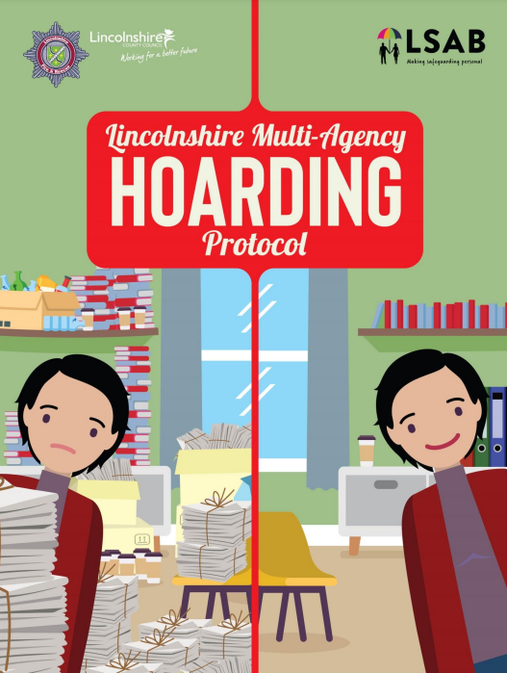
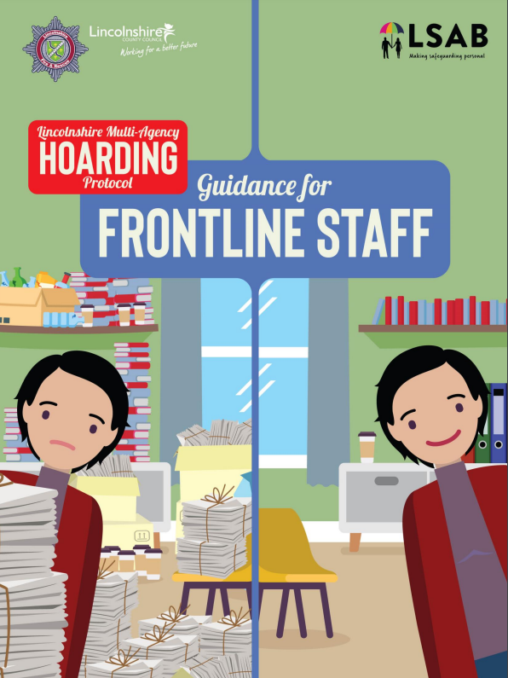
Hoarding and Clutter Scales
The quality of housing conditions is identified within the neglect Scales as a potential area of care linked to neglect. There is a joint protocol in place in Lincolnshire which provides support and guidance on responding to Hoarding. This includes useful images and a Clutter Scale which can support practitioners to assess risk and respond.
Click on the image to read Learning Bulletin ‘Bryony’. This local case identified key learning around assessing clutter and the risks
associated.
This includes Practitioners being more descriptive in their narrative on home conditions, especially where there are worries about this impacting on the safety and development of the children. The Clutter Scales and Hoarding protocol, available below, to support practitioners with this.
Professionals should consider a range of things when looking at the hoarding protocol and clutter scales to assess the environment alongside the child’s safety and developmental needs. This includes clean, safe places, free from clutter, for:
Clutter can increase risk in certain circumstances, some examples include where:
Professionals should use observation alongside the clutter scales to evidence how the space is used by the child and what impact this might have on the child, considering any additional needs that might increase risk of harm.
Click on the images to be taken to the relevant guidance
sleeping | tummy time | personal hygiene
crawling/walking | eating | socialising
playing | studying | privacy
Medication is not safely stored | Fire safety is not adhered to
Raw food is accessible | Rooms are not accessible
Animals are poorly cared for | There is poor ventilation and/or mould
Animal Faeces and Urine is not cleaned | Heavy items are stored insecurely
Temperature control is affected | Access to or space for necessary equipment is limited
The full protocol is available here
This guidance includes the clutter scales and how to use this in assessments

Slide 67
Responding to Substance and Alcohol use
The LSCP Policy ‘Safeguarding Children Affected by Problematic Drug and Alcohol Use (Parental and Child Use)’ has been developed to support practitioners. It also includes a links to a range of helpful resources that can support. | Using the Cycle of Change can help set questions to ask. Depending on where the person is in the cycle will help determine responses needed. | This ‘LSCP Substance Use Parenting Checklist’ can be used to help identify and assess the level of risks understand the substance use.
This ‘Alcohol screening tool’ can be used to understand: How much alcohol someone is drinking, Their reasons for drinking Whether they might consider change Who might help them with this change What barriers there might be What needs to happen next This can assist in motivational conversations and planning. | If you are aware that substance use is impacting on care, consider Oasis Family Support Service. Turning Point is a great resource to learn more and make referrals to Lincolnshire Recovery Partnership | The LSCP 6-Year Safeguarding Children Pathway includes the below training courses which can support practitioners: Understanding the Trio of Vulnerabilities (eLearning) The Impact of Drug and Alcohol use on Families (1-day face-to-face course) Further information can also be located on the NSPCC website.

Slide 68
Responding to mental health, wellbeing and trauma carer
The LSCP Parental Mental Health guidance can offer further information. Healthwatch Lincolnshire published a report in 2023 titled Maternal Mental Health which provides further context on this area. | Using the Cycle of Change can help set questions to ask. Depending on where the person is in the cycle will help determine responses needed. The assessment triangle highlighted earlier can also support when responding to mental health and wellbeing. | This short video gives an overview of perinatal mental health and can be used with carers, if appropriate- Perinatal Positivity. Carers can be directed to this site for further understanding on how mental health can impact on parenting - parenting and mental health
Resources for professionals and families can be found on the below sites: How Are You Lincolnshire provides an overview of services in Lincolnshire and useful resources available. HAY plus – provides access to useful resources, training, and support for professionals Connect to Support Lincolnshire holds details on Mental Health advice and support across Lincolnshire and can provide details on local services, specialist and nationals services that might help. Lincolnshire Recovery college provides access to a range of free courses available to anyone over 16 living in Lincolnshire If there is a sudden change for an adult that impacts them, you can consider a Wellbeing Lincs referral. Mind provide additional information around parenting and mental health. PANDAS offers support for pre and postnatal depression. RISE are a trauma informed service that can help women to access support. Where there is a need for advocacy, please visit Voiceability for additional details. If the carer has a care and/or support need, support from Adult Social Care may be required or in place. This website provides an overview of services, support and details on adult safeguarding processes. |  | The LSCP 6-Year Safeguarding Children Pathway includes the below training courses which can support practitioners: Zero Suicide Alliance Training (eLearning) Understanding Healthy Parental Relationships and its Impact on Child Outcomes (eLearning) Recognising and Supporting Parents in Parental Conflict (eLearning & Virtual Workshop) Understanding the Trio of Vulnerabilities (eLearning) Domestic Abuse training package (further information available here) The Impact of Drug & Alcohol use on Families (1-day face-to-face course) Trauma Informed Practice (eLearning *Coming Soon*)
More information available on the next two slides

Slide 69
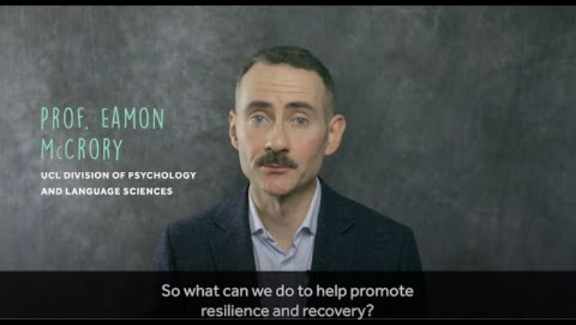
This Anna Freud video (11:29) follows on from the earlier childhood trauma and the brain video. It provides some tips on working with children, which can be adapted to work with carers too.
Responding to Trauma

Slide 70

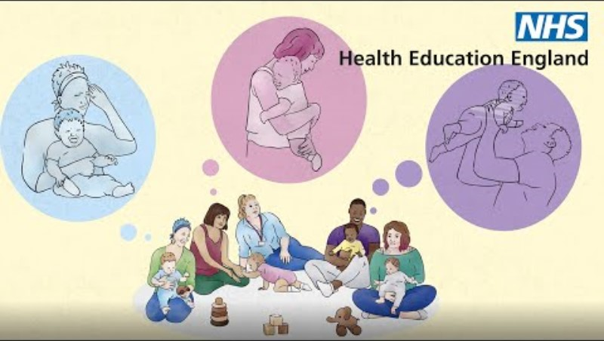

Responding to the Trauma
This selection of videos may be used to help you think about your approach and deepen your understanding of how to respond. You may find sharing the resources beneficial in your teams or even with carers, where appropriate.
This video (5:15) by the Department for Education shares Emma’s Story. It demonstrates the long-lasting and generational impact of neglect. | In this NHS England video (3:12) Pippa’s Story, there is insight into early experiences of becoming a parent and learning about love with support of professionals. | This further Solihull resource (5:47) focuses on the importance of containment, touching on a carer being triggered whilst dealing with stressors and the caring role. It moves into how to build in support for the carer.

Slide 71
Responding to Domestic Abuse
To understand Domestic Abuse further, visit the Domestic Abuse Website The Lincolnshire Domestic Abuse Partnership have a professional's page which hosts resources, risk assessments, guidance, referral forms, joint protocols, process maps and further information regarding Domestic Abuse and the response in Lincolnshire. Please do not share this site link with families. | The cycle will help determine responses needed. The Power and Control Wheel can be used to understand more about Domestic Abuse. | The DASH risk assessment and guidance is available on the professional resources site. This tool should be completed where concerns exist around Domestic Abuse.
There are several services available to support anyone experiencing Domestic Abuse I |  | The LSCP 6-Year Safeguarding Children Pathway includes the below training courses which can support practitioners:
Lincolnshire Domestic Abuse Specialist Service | HAVEN DA Service
ManKind Initiative - Supporting Male Victims of Domestic Abuse | Paladin – National Stalking Advocacy Service
National Domestic Abuse Helpline | Domestic Abuse Helpline for Men | Men's Advice Line UK
Galop - the LGBT+ anti-abuse charity | EDAN Lincs
Moving Forward Lincoln | Rights of Women
Domestic Abuse Awareness – Short Course (eLearning) | Children Who Experience Domestic Abuse (eLearning)
Men Who Experience Domestic Abuse (eLearning) | Domestic Abuse – DASH (eLearning)
Domestic Abuse- Importance of Language (eLearning) | Domestic Abuse – MARAC & MOP (eLearning)
Domestic Abuse in Practice (eLearning) | Domestic Abuse in Practice (1/2-day face-to-face course)
Understanding the Trio of Vulnerabilities (eLearning) | Trauma Informed Practice (eLearning *Coming Soon*)
More information available on the next slide

Slide 72

Responding to Domestic Abuse
For further details on supporting children and families impacted by domestic abuse watch this short video (4:45) by NSPCC.

Slide 73

Responding to learning and communication needs of family / carers
The Equality Act (2010) places a statutory duty on employers, healthcare settings and wider society to make reasonable adjustments to ensure equity of access to services for people with a disability, by making changes in their approach or provision. This All our Health guide may be useful to consider. | LPFT’s Learning Disability Service & Autism service work with service users, families, social care and health partners to enable adults with a learning disability and/or autism living in Lincolnshire to receive the right care in the right place at the right time. The LPFT Virtual Autism Hub provides advice and support on Autism. How Are You Lincolnshire can identify services that support throughout Lincolnshire. ​ If the carer has a care and/or support need, support from Adult Social Care may be required or in place. This website provides an overview of services, support and details on adult safeguarding processes. Where there is a need for advocacy, please visit Voiceability for more details.
The ABCs of inclusion are a good place to start in relation to communication and empowerment.
Research in Practice offers more on working practice, research and challenges. Additional resources are also available from IRISS and Bristol University
CAFCASS have a range of tools available that can help to explore strengths, difficulties and ways to communicate There are additional specialist tools available that can help to explore a hypothesis. This includes tools around Autism and Learning disability. If you would like to request access to these tools you can do so by emailing LSCP@lincolnshire.gov.uk | The LSCP 6-Year Safeguarding Children Pathway includes the below training courses which can support practitioners:
Click the above image to listen to a Podcast from Research in Practice where Dez Holmes, Director of Research in Practice and Research in Practice for Adults talks to Danielle Turney and Beth Tarleton, the authors of a recent strategic briefing on supporting parents with learning difficulties.
The podcast is under 1 hour in length.
A Rough Guide To Not Putting Your Foot In It (eLearning) | An Introduction to the Autism Spectrum (eLearning)
Special Educational Needs and Disabilities (SEND) (eLearning) | Valuing SEND approaches and Tools (eLearning)

Slide 74
Responding to environment and intersectionality
Too little, too late: A multi-agency response to identifying and tackling neglect is an NSPCC review that addresses issues such as poverty and neglect and comments on policy challenges. The relationship between poverty and child abuse and neglect is further illustrated in this Nuffield Foundation report. NICE provide information and suggestions regarding a strength-based approach that can address achievement through what a family has within its own resources. John Burnham’s Social Graces is a useful tool that can be used to understand a person’s identity. This Anna Freud poster may be useful to populate with carers. Listen Up are a research organisation that cover Adultification and Intersectionality, including tools to use when considering the impact of these. Voiceability can provide advocacy support for children and carers. This includes advocacy at child protection conferences and for a range of other advocacy needs which may exist due to environmental or intersectional factors.
The Think Family Slide earlier in the resource covers a number of these factors, including: General resources Criminal Justice System Bereavement & Suicide Caring Responsibilities Housing needs Parental Conflict and Separating Families and Employment Support The LSCP Child Abuse linked to Faith or Belief Policy may be useful where there are concerns around this type of abuse. | The LSCP 6-Year Safeguarding Children Pathway includes the below training courses which can support practitioners: Child Poverty (eLearning) Female Genital Mutilation (abuse linked to faith or belief) (eLearning) Trauma Informed Practice (eLearning) *Coming Soon* Additional learning can be undertaken by considering the below: Listen Up Research have produced a range of publications and podcasts which are useful to consider. The NSPCC have also produced a podcast (33:15) which asks “are you taking an intersectional approach when working with children and young people” An additional podcast (29:49) available through Research in Practice focusing on Using intersectionality to increase equity: a discussion about the Equity Change Project is useful to consider. Additional RiP information, tools and resources on the Equity Change Project can be accessed here.

Slide 75
Responding to children with additional needs
Mind offer information for carers and families on supporting children with their mental health and wellbeing. LPFT offer a range of support to children, carers and professionals. Including online workshops and supportive resources. Recovery College online have a range of courses available for young people. | A resilience or vulnerability matrix has been produced by CAFCASS which could assist in understanding any additional needs, resilience and vulnerability factors. CAFCASS have a range of other tools available that can help to explore strengths, difficulties and ways to communicate. There are additional specialist tools available that can help to explore a hypothesis. This includes tools around Autism and Learning disability. If you would like to request access to these tools you can do so by emailing LSCP@lincolnshire.gov.uk
Effective and child focused safeguarding practice with disabled children ensures they are seen, heard and supported. The LSCP Abuse of Disabled Children Policy can offer further information. The SEND Local Offer can be accessed here, which provides information and support around Special Educational needs and disabilities. The Safeguarding Disabled Children: Practice Guidance is available here and may be of use to consider. Further safeguarding information is contained in the NSPCC website. | The Family Fund charity can be utilised in looking for support, resources and financial support information for children with disabilities. Where there are special educational needs and disabilities the education setting, including early years settings, may be able to complete the Valuing SEND tool. This tool is useful in understanding how the home environment may differ from the school environment and can highlight where the needs of the child are not being met. The SEND Advice Line for Lincolnshire (ASK SALL) can be contacted for support and advice for professionals. Parents can contact Liaise for advice. The Lincolnshire Parent Carer Forum may also be a source of support for them. | The LSCP 6-Year Safeguarding Children Pathway includes the below training courses which can support practitioners: Additional learning can be undertaken by considering the below: The Council for Disabled Children offer a range of free eLearning which might be useful. Serious Case Review Child B (Hackney, 2021) and this National Child Mortality Database Report provides an understanding of the cumulative impact of health needs remaining unaddressed.
A Rough Guide To Not Putting Your Foot In It (eLearning) | An Introduction to the Autism Spectrum (eLearning)
Special Educational Needs and Disabilities (SEND) (eLearning) | Valuing SEND approaches and Tools (eLearning)
Building Resilient Foundations (Virtual Workshop) | Self-Harm (eLearning)
Suicidal Thoughts (eLearning) | Early Child Development – Foundation (eLearning)

Slide 76
Responding to Exploitation
Some risk of harm comes from outside the home. The biggest period of growth in our brains is in the first three years of our lives and then, after this, during adolescence. Developmentally, at this later stage of growth, there is likely to be a natural move away from carer towards peer relationships and risk taking may increase.
Consideration should be given to the measures and responses from carers where supervision is concerned. Places and spaces offline (community) and online will require parental oversight. The following slide provides resources on online safety that might be useful where online harm is a risk.
Where a child has or is continuing to experience neglect, they may be more at risk of exploitation if they are seeking love, care, connection and/or validation outside of their home environment. This could mean that a child spends more time in the community or online than a child who has and continues to have a safe and secure home environment.
Whether or not there are concerns around neglect and supervision, which increase the risk of exploitation, practitioners should respond accordingly following the Multi-Agency Child Exploitation processes, and signs of exploitation can be found in this guidance. Where safety plans exist, professionals should consider whether neglect might have an impact on the carer’s response to risk. For instance, does the carer understand the risk to the child? Will the carer report the child missing?
Where the young person is over 16 and is staying away from home, a youth homelessness response should be considered. Where the person in staying with friends, please also refer to private fostering.
LSCP 6-Year Safeguarding Children Pathway includes the below training courses: | Working together 2023 includes some useful information working with parents in these circumstances. These Practice Principles are useful to consider in relation to responding to child exploitation or extra familiar harm. Local resources relating to exploitation are also available. | A Rapid Read on County Lines is available here. There are a further two 7-minute briefings available from NHS Lincolnshire below: Contextual Safeguarding and Child Exploitation.
Tackling Exploitation and Modern Slavery in Lincolnshire (eLearning)
Child Exploitation and Extra-Familial Harm (eLearning)
Child Exploitation in Lincolnshire (1-day Face to Face course)
Child Sexual Abuse (eLearning)
Awareness of Private Fostering (eLearning)
More information available on the next slide

Slide 77






Responding to Online Safety
There are several resources available that raise awareness about harms online and offer resources to help increase safety for families
the LSCP Policy holds information and resources.
Practitioners can use some dedicated sites to plan and deliver support and educational sessions with families or to share with families
NSPCC Provides details on keeping children safe online. | Stay safe partnership Provides access to information and training for schools and carers The Stay Safe Partnership YouTube channel also hosts a range of useful videos on online safety. | CEOP Education Access to training and resources for professionals, carers and children. The CEOP Safety Centre provides further details on reporting online behaviour. | Shore A safe space for teenagers worried about sexual behaviour. | Internet matters Provides useful safety checklists, advice on moving from primary to secondary school, setting controls and links to additional resources. | UK safer internet centre Provides online safety advice for professionals and carers on a range of online topics.
Where concerns around neglect exist, there may be increased risk of online harm. It would be useful to discuss the below with carers.
The LSCP 6-Year Safeguarding Children Pathway includes access to a range of courses which might be useful including –
Child Exploitation and Extra-familial Harm (eLearning)
Child Exploitation in Lincolnshire (1-day face-to-face course)
E-Safety (eLearning)
Online Safety (Virtual Workshop)
Carer supervision | Setting age restrictions
Grooming | Self-generated images
Malicious communication | All forms of online harms

Slide 78
Responses during pregnancy
There are several free Solihull parenting eLearning courses that are available to carers and wider family members which cover key parenting stages, including during pregnancy. The Start for Life webpage provides details on Lincolnshire’s online offer of support during pregnancy and the first two years of a child's life. Family Hubs are available to support families and carers with parental responsibility can join children's center here. Better Births Lincolnshire is a health website for pregnancy with links for support in planning during and post pregnancy, with health and advice in all situations. In some circumstances, agencies or individuals are able to anticipate the likelihood of significant harm regarding an expected baby (e.g. where there is information known about domestic abuse, parental substance misuse or mental ill health).These concerns should be addressed as early as possible before the birth using the LSCP Pre-Birth Protocol. This ensures a full assessment can be undertaken and support offered to enable the carer/s (wherever possible) to provide safe care to the baby. The LSCP Concealment and denial of Pregnancy and Birth Policy might also be useful to consider when this presents as an issue.
ICON is a preventative approach that helps carers cope with a crying baby. This NHS 7-minute briefing provides additional details about this approach. The Parent Infant Foundation hold useful resources for parents and professionals around supporting relationships between parents and infants along with infant development. This short video (2:00) produced by ICB Lincolnshire with support from Lincolnshire Police for ICON Week 2024 provides more details. The LSCP 6-Year Safeguarding Children Pathway includes a free eLearning course titled ‘ICON: Babies Cry, You Can Cope’.
Click on the image to listen to an NSPCC podcast (26:00) on supporting new parents through adversity.
This is part one of a discussion about how therapeutic and trauma-informed early intervention services can support families through adversity and give children and young people the best start in life

Slide 79
Remember…
Early Identification is key
Use the term neglect with families as early as possible
Use the information and tools available in this resource to support with all cases where neglect is a factor. Where you are unable to make progress use the reflective exercises and support suggested to work on moving cases forward.
Use the shared language in this resource and on the Scales to inform your assessments and referrals. All partner agencies in Lincolnshire have been involved in the creation of this resource and will be working with the same approach. Therefore, it is important that this language is used, and the tools completed are shared with other agencies during early help responses and when making referrals.
Where concerns exist around a lack of engagement with services ask what this is telling you. Consider reasons for this non-engagement and think about who the best person or service could be that will encourage engagement. This could include engaging with the wider family network or different professionals.
Access support and supervision regularly through line managers, supervisors, early help consultants, safeguarding leads, professional and community networks, and colleagues.
The use of chronologies will avoid drift in cases. Record any instances of non-engagement or action not being taken on a chronology as well as significant incidents, events and impacts.
Hold the impact on the child/ren at the foremost of your thinking and curiosity.

