Slide 1


Nottingham University Hospitals
East Midlands Children and Young People Sexual Assault Service
(EMCYPSAS)
Kathryn Harley
Specialist Nurse

Slide 2

Queen’s Medical Centre- Nottingham Serenity- Northampton
Our service runs two centres that are just for children and young people under the age of 18.
They are in Nottingham and Northampton and the services are completely free.

Slide 3
Queens Medical Centre

Slide 4
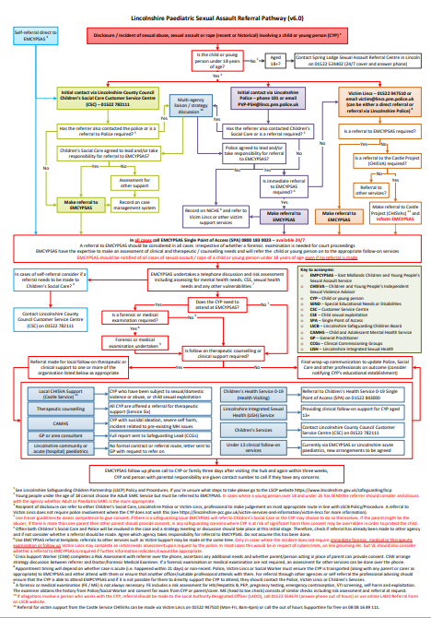
Lincolnshire Paediatric Sexual Assault Referral Pathway
Click on the image for the
Lincolnshire Paediatric
Sexual Assault Referral Pathway

Slide 5
Professionals who support at EMCYPSAS
Specialist Nurse
Social Worker
Therapeutic Support Worker
Crisis Support Worker
Specially trained Doctor
Young Person’s Advocate/
Children Independent Sexual Violence Advisor (ChISVA )
Specially Trained Police Officer

Slide 6

The role of the Specialist Nurse
A trained nurse with extensive experience in safeguarding and working with young people and their families, will support the young person with both recent and non recent examinations
Clinical support for clinician-bloods, test etc
Advocacy role for the CYP within the SARC
Family support within the SARC
Multi-agency working eg Multi Agency Child Exploitation (MACE)
• Discuss options of onward referrals
Therapeutic/ CHISVA support
Paediatric follow up
Refer on to integrated sexual health services

Slide 7
Role of Crisis Support Worker
The role of the Crisis Support worker who support onward referrals
A compassionate and supportive professional
Advocacy role for the CYP within the SARC
Family support
Discuss options of onward referrals
Which could include;
Therapeutic support
ChISVA service
Safeguarding referral

Slide 8

Single Point of Access for Advice Referral 0800 1830023
Single point of access answered by a Crisis Support Worker (CSW)
24 hours per day, 7 days per week, 365 days per year
9am - 7pm working days
9am - 5pm weekend and Bank Holidays
Acute sexual assault/abuse (within 21 days)
Non-recent assault/abuse (more than 21 days)
CYP up to the age of 18
Adults with significant needs (e.g. learning disability) up to age 24 years
Young people 16-18 have a choice as to whether they access the CYP or adult services. If adult services are willing to see them.

Slide 9

Lincolnshire Paediatric Sexual Assault Referral Pathway
“A Referral to EMCYPSAS should be considered in all cases irrespective of whether a forensic examination is needed for court proceedings.
EMCYPSAS have the expertise to make an assessment of clinical and therapeutic/counselling needs and will refer the child or young person onto the appropriate follow-on services.
EMCYPSAS should be notified in all cases of sexual assault/rape of a child or a young person under 18 years of age even if no referral is made”

Slide 10

Why Refer?
“Sexual abuse or assault is everyone's responsibility”
A Referral to EMSAS can access to:
A holistic risk assessment
Collection of forensic evidence
Documentation of injuries
Prevention of unwanted pregnancy
Prevention and detection of sexually transmitted infections
Reassure for the child/young person and their carers
Onward referrals
Vulnerabilities may include:
Pregnancy
Sexually Transmitted Infections
Self-harm
Domestic abuse
Child Sexual Exploitation
Female Genital Mutilation

Slide 11
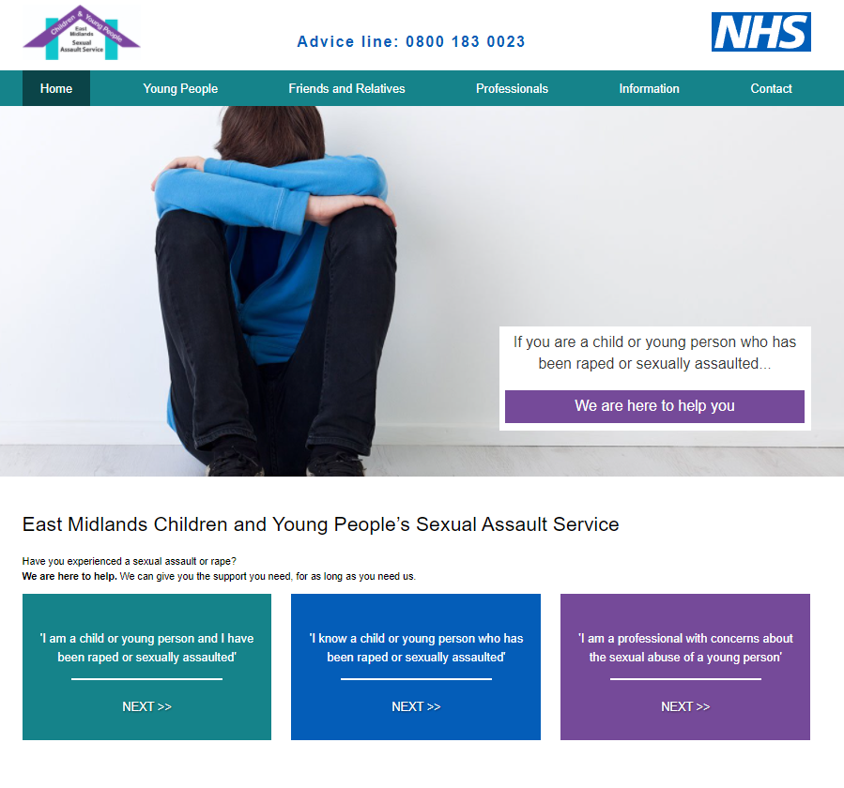
East Midlands Children and Young People Sexual Assault Service
Lincolnshire Paediatric Sexual Assault Referral Pathway: www.lincolnshire.gov.uk/safeguarding/lscp
www. lincolnshire.gov.uk/safeguarding/lscp
www.emcypsas.co.uk

