Slide 1
South Gloucestershire's Preparing for Adulthood Team
(formally known as the Transitions Team)

Slide 2
Context
PFA Team sits within Integrated Children’s Services, embedded within the 0-25 social care service, which consists of; a 0-18 disability childrens and a 16-25 adults disability team with a smaller Occupational Therapy Service 0-18.
The team take referrals on an ‘enquiry form,’ from social care colleagues across S Glos. CAH (Childrens 'Adults and Health) Dept and/or schools/colleges/SEND Team when a young person has an EHCP, from year 8/9 up to the age of 25 years.
There has to be either/or, as we do not take self referrals.
The enquiry form needs to identify which destination or outcome is required in maximising the best potential for the young person
We are a short term service of up to 26 weeks.
We listen to young peoples’ aspirations and advocate and signpost to enable young people to be the best version of their self.

Slide 3
Purpose
To help facilitate and support young people, their families, partner organisations, providers and communities to find solutions that enable young people to continue to live at home or independently within their community whilst supporting the Local First Framework.
We are outcome focused in our approach; therefore there needs to be an identified goal.
In working directly with young people to include them within their community we utilise local resources to avoid the need for social care involvement until essential.
Young people to feel listened to.

Slide 4
What we do: Direct and Indirect and work and attend targeted EHCP Reviews
The Team provide three specific areas of work:
Direct work: where the team will work on a 1-1 basis with the individual to prepare for transition.
Direct work includes travel training to build the skills and confidence to travel independently. Sharon, our Travel coordinator, will provide more information.
Indirect work: where the team will work within an educational setting or with a professional, providing transition knowledge to ensure clear, achievable and sustainable outcomes are agreed.
Reviews - where the team will attend the young persons annual review from year 8/9 to provide indirect advice and guidance around transition and identifying outcomes and promoting the local offer
We work with our social care colleagues, especially the 16-25 team, in a strength based and person centred approach when we have consent.

Slide 5
What we do and offer-supported by our Transition booklets
Working across four areas the team help young people:
gain skills and prepare for further education, employment, training or volunteer work,
help young people be part of their communities and build friendships - travel training is embedded in this pathway.
guide and support young people to develop independent skills and maintain/seek new accommodation options.
guide young people to staying safe, maintain wellbeing, remain healthy and connected into health services where appropriate.

Slide 6
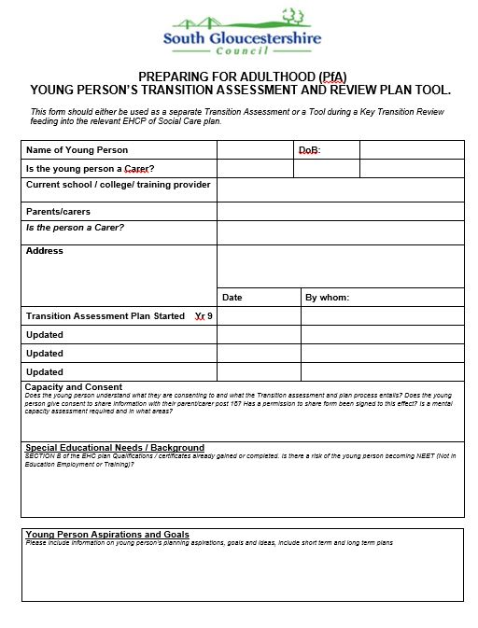
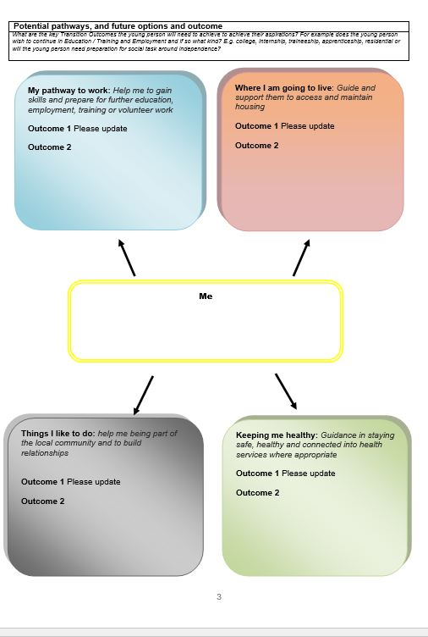
Other resources
For young people without social care involvement but with social care needs we use a Transition Assessment to map their needs against our Pathways, at age 15 and 17 ½, as a transitions document.
PFA is a Steering group member of the Moving On project (Blackhorse House supported living) http://www.southglos.gov.uk//documents/Blackhorse-House-leaflet-20-June-2018.pdf
We promote the use of the Transition health check list and the Hospital Passport at reviews.

Slide 7
Process
The referral comes into the team, through our PfA mailbox.
Each referral is discussed at our Transition Operational Group (TOG) meeting, where representatives from social care and SEND are present.
Referrals will be allocated on a sliding scale of urgency, hence those allocated before TOG are still discussed for audit purposes.
A Transition Facilitator is allocated, once outcomes are clear, risk assessed. If direct work is required, it will determine the skill set of the best match between young person and a Transitions Assistant to complete the direct work identified.
Developing trust and an understanding between the young person and assistant is key in making a positive start to engagement led by a person centred approach with the individual.
If 1:1 support isn’t needed, written information is produced (an Indirect Summary) outlining opportunities against interests/the young persons goals.

Slide 8
Supporting young people to travel independently
Travelling independently can result in positive changes to young peoples life skills and behaviour, as they develop transferrable skills that can broaden their future outlook and horizons.
Travel training can increase independence and confidence and improve self-esteem. This may contribute to general health and well-being and improved quality of life.
Independent travel promotes community presence through increased opportunities to participate in social and leisure activities as well as the ability to access education or employment independently.
Travel training seeks to promote young people’s choices and opportunities

Slide 9
How travel training works.
Travel training is practical, community based and can be in real time. Sessions usually take place once a week.
The travel training will be for a specific route to an identified destination that the young person will realistically use once they have demonstrated independence.
May consist of walking, crossing roads and using public transport – buses and trains.
1:1 sessions with an identified Transition Assistant who will support with all aspects of the route, and will step back gradually as the young person becomes more confident and is able to take responsibility
Covers personal safety and strategies while encouraging the use of mobile phones and apps to support independent travel, including for when things may not go as expected.
Travel training is complete when the young person has demonstrated independence and confidence with all aspects of the route and is able to travel alone.
The number of sessions will depend on the progress of the young person.

Slide 10
Process to access travel training
Referrals for travel training can be made via self-referral or by schools, Social Workers, SEND Team, PFA Team.
The Travel Training Coordinator will arrange a meeting to discuss travel training with the young person and their parent/carer and gather necessary information relating to young persons needs.
A Transition Assistant will introduce themselves to the young person and plan the first session.
If travel training is deemed not to be appropriate, this will be recorded
Contact: traveltraining@southglos.gov.uk

