Slide 1
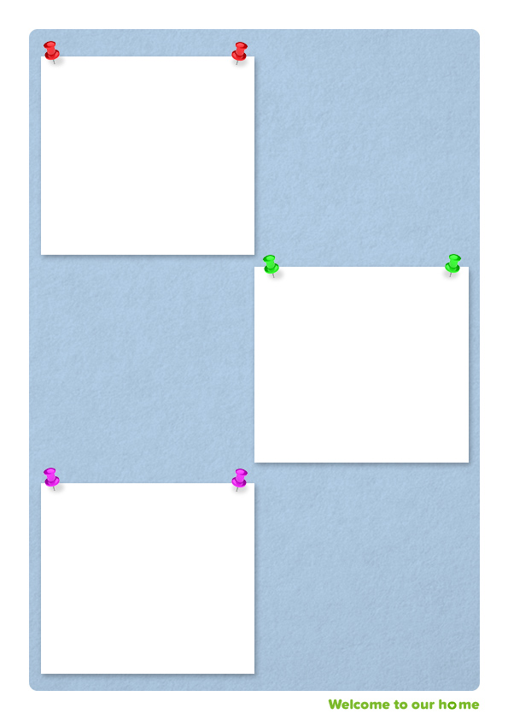
Top tips on writing young people’s profiles
Tip 1: Involve the child-consider can they write their own profile or at least contribute? What is their hope from a new foster carer?
Tip 2: Describe their behaviour-don’t just label it.
Tip 3: Be positive and honest-but always give context!
Tip 4: Emphasise the family culture they are used to.
Tip 5: Include information from people who know them well-e.g. family, workers or previous foster carers.
Tip 6: Include the support already in place for them and carers.
Tip 7: Include the young person’s strengths/interests/hobbies.
“We have been ‘collecting material’ for the story from Day One, even though we don’t remember Day One. The years of infancy and childhood provide us with some of the most important raw material for our identities”
(Social Constructionist, McAdams, 1993)
Tip 8: Make any health needs clear and any risks to the child or others.
Tip 9: Write what ACES (adverse childhood experiences) are relevant to the young person and how they may impact on them.
Tip 10: Write as if the young person was your reader-because they may be one day!

